Slide 1

Welcome to Year 6!
Notes:
TH

Slide 2
Year 6 Team
SH6 – Mrs Huckle, Mrs Brock and Miss Swanborough
RD6 – Mrs Robertson, Mrs Day and Mrs Tuffs
TH6 – Mr Hodgkiss, Mrs Wyer and Miss Dean
Notes:
TH

Slide 3
Topics
Autumn 1 – Vikings – Light – Viking Boy
Autumn 2 – Crime over 1000 years – Circulatory System – Macbeth
Spring 1 – Mayans – Evolution
Spring 2 – Rainforests – Living things and their habitats
Summer 1 – North America – Electricity
Summer 2 – South America – Transition Project
Notes:
SH

Slide 4
Things needed in school
Water bottles
PE kit on a Monday, take home on a Friday
PE kit must be a change of clothes and safe hair
Healthy snack – fruit or veg (Nut-safe school – no nuts please)
No make up, nail varnish or jewellery (stud earings only in each ear – take out for PE, county rule).
Home-School books to be brought in every day along with home or school reading book.
Phone privilege - safeguarding and expectations
Notes:
BD – Reminder to say boys and girls need to bring separate trousers and tops for PE to change. Girls need to be able to take put and put back in earrings

Slide 5
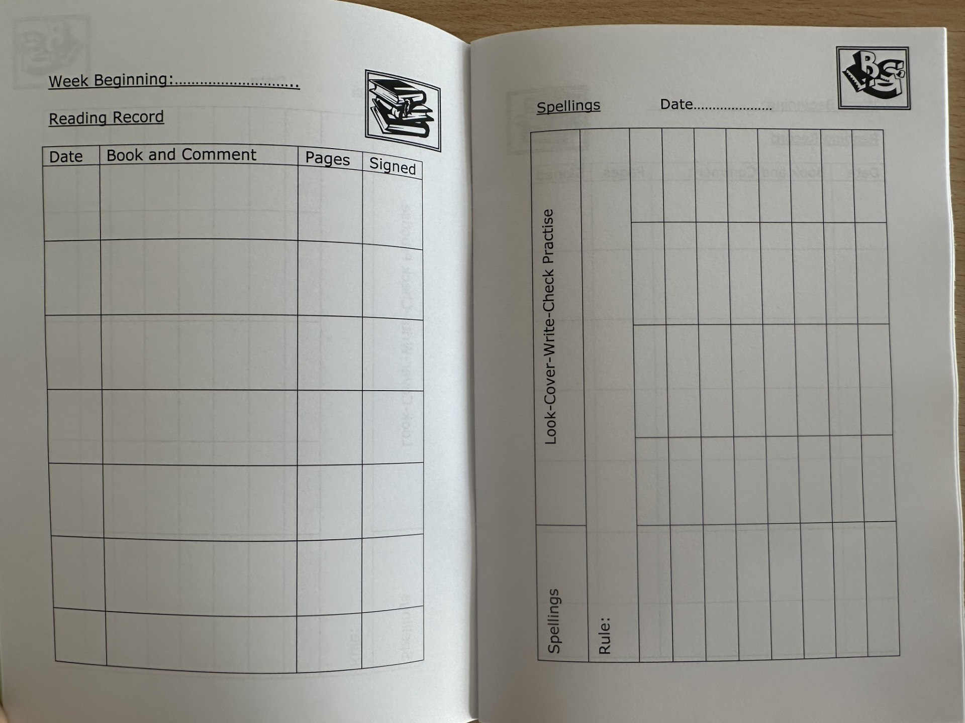
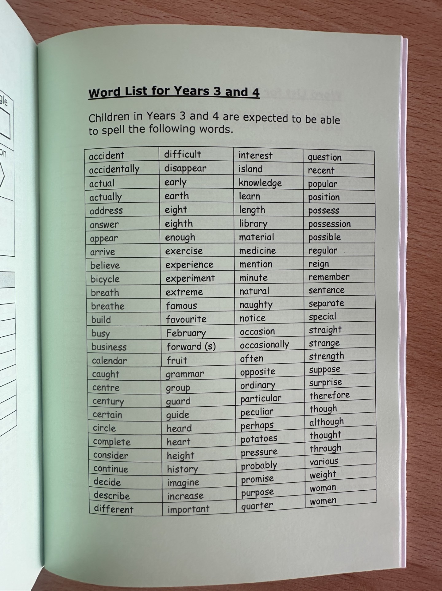
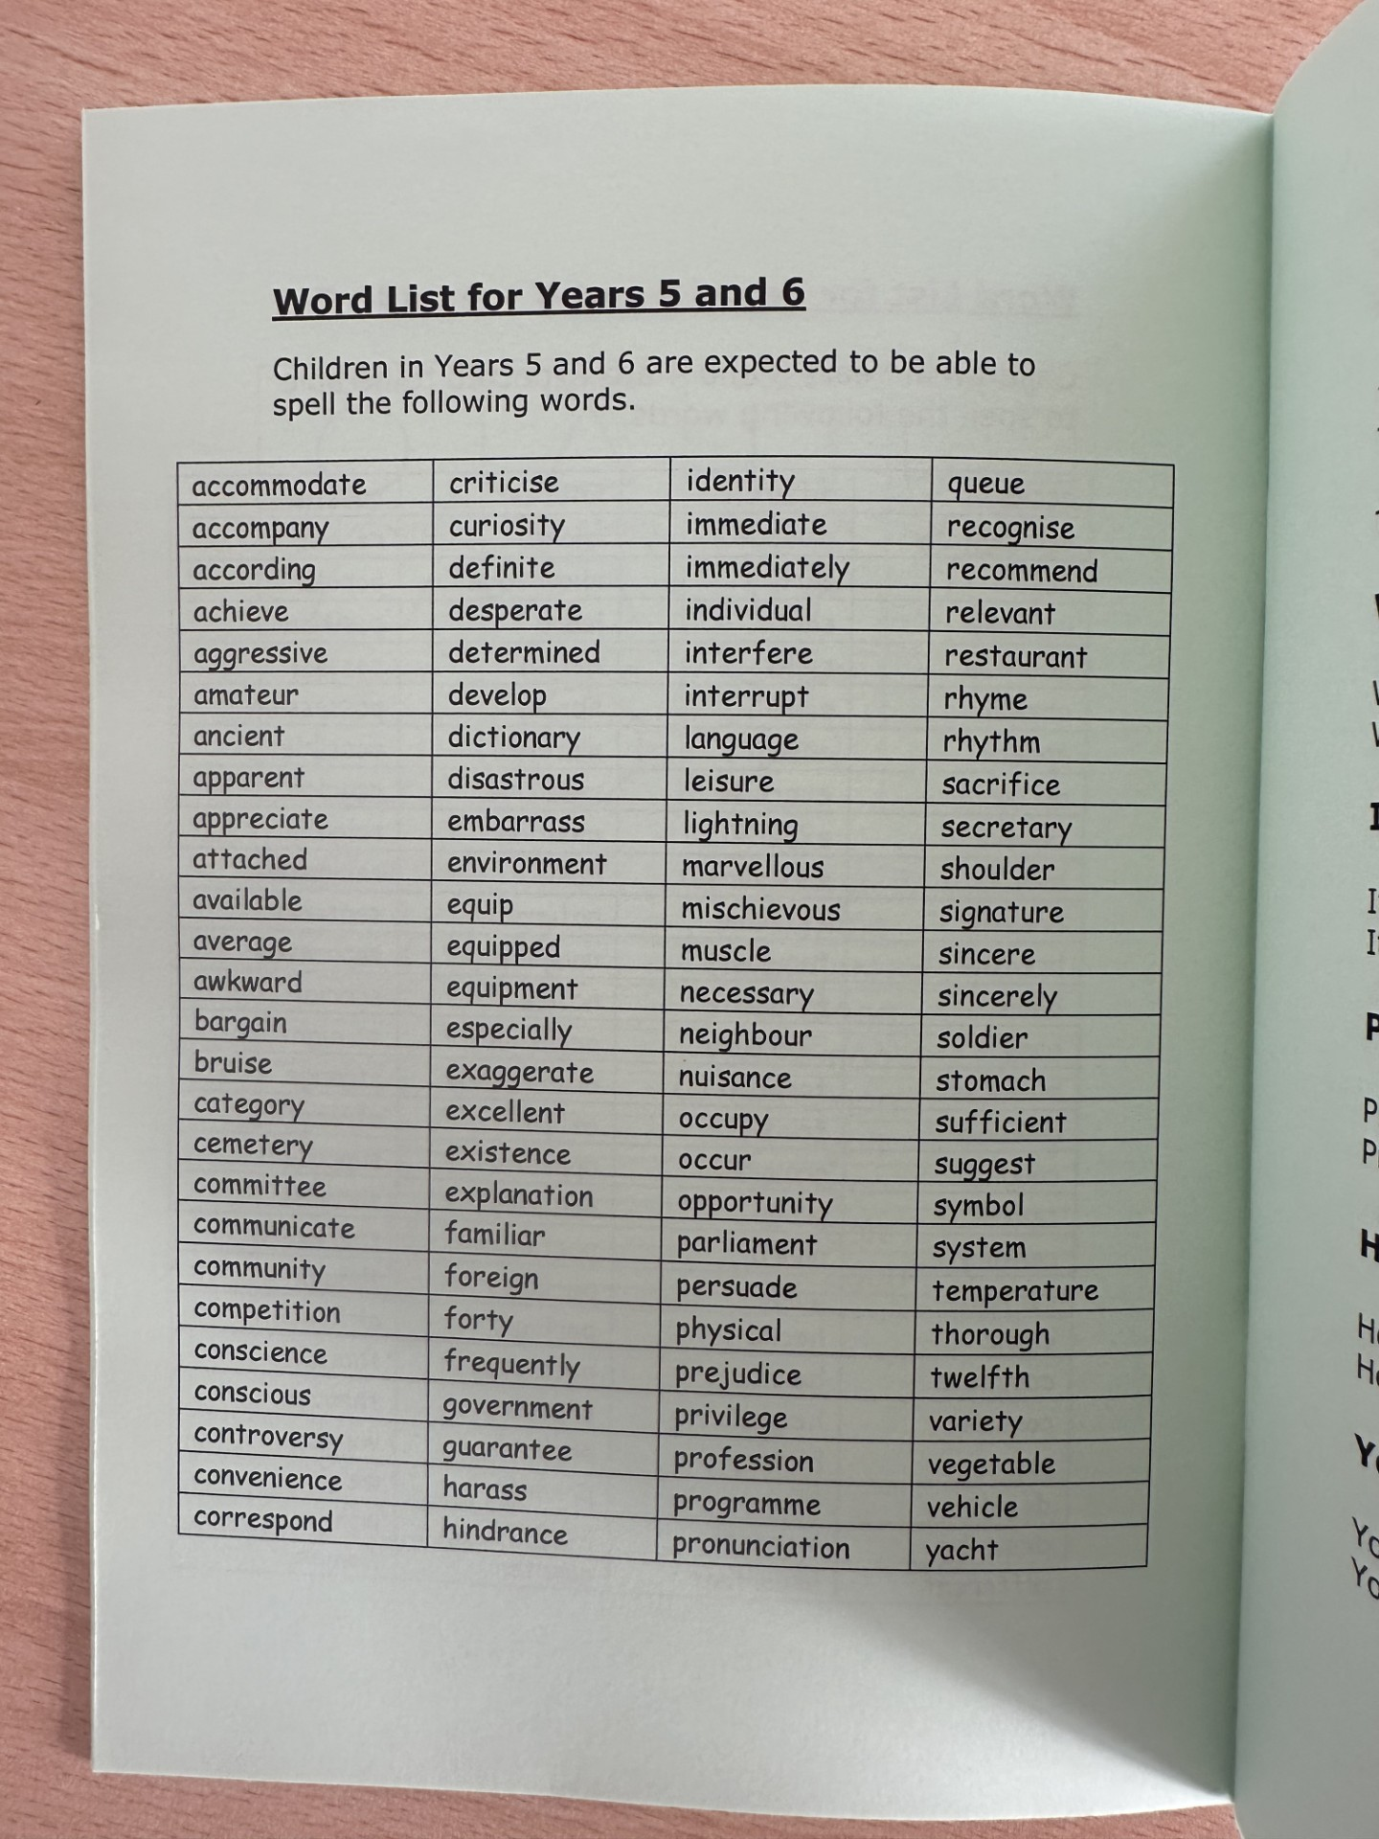
Homework
Home/School books – used for reading and spellings (Monday – Monday)
Notes:
TH

Slide 6
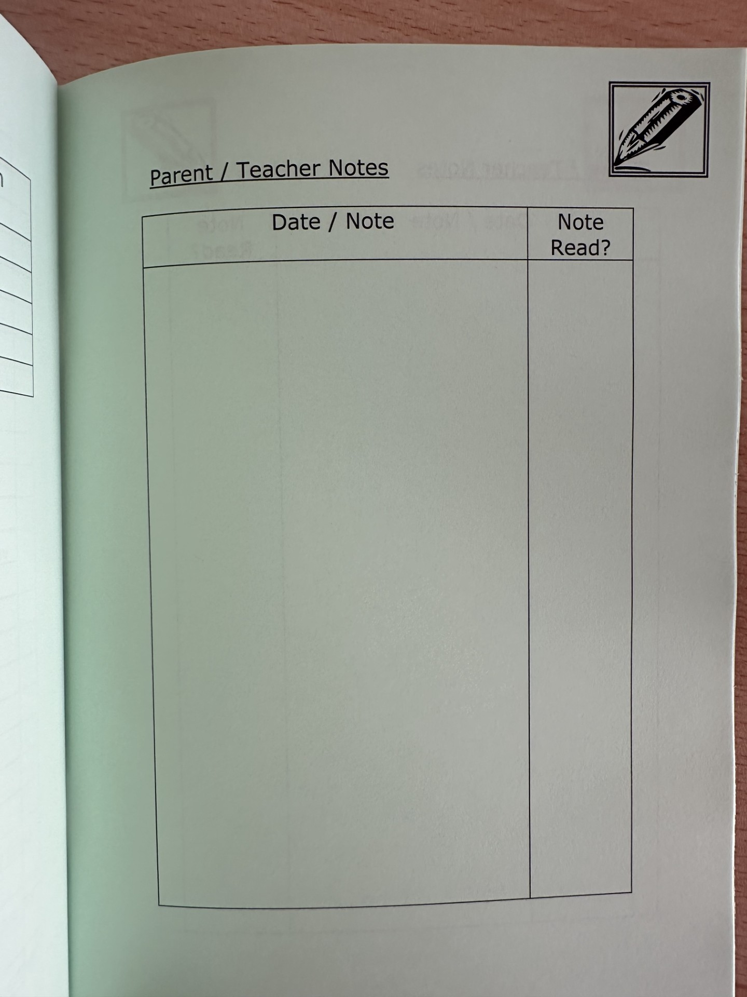
Homework
Home/School books – any notes to the teacher.
Notes:
TH – Or email the office and they direct to us

Slide 7
Homework
Handed out on a Wednesday to be handed back in by Monday.
TTRS session
Maths Homework – Mathletics one week, paper the next
A task, relating to one of our topics, will be stuck into their Learning Log and they can complete it over the double page. This will be creative and engaging for the children.
When maths is a paper worksheet, this will be in their Learning Log.
This will start next Wednesday (16th), with maths homework being on Mathletics.
Spellings each week
Notes:
TH

Slide 8
Trips
You will receive a letter asking for your consent for things like local trips.
We have a residential planned for Year 6 – you will receive more information about this in due course. It is earlier this year (21st June – 23rd June).
Please make sure you return any consent forms as soon as you can!
Upcoming events:
Harvest Assembly – 7th October
Christmas Concert - 16th December
Crime and Punishment Museum Trips in November
Spring – SATs information evening
Ukulele Performance – Following Lessons
End of Year Production
Notes:
SH

Slide 9
Class Assemblies:
TH6 Thursday 28th January
SH6 Thursday 4th February
RD6 Thursday 11th March
Notes:
BD

Slide 10
School Arrival
We noticed that some Year 6 pupils are arriving at school significantly before the start of the day and gathering outside the school.
As there is no staff supervision available, we kindly ask that children do not arrive before 8:30am.
Please help to ensure all pupils remain safe by arranging for your child to arrive at school from 8:30am onwards.
Thank you for your support and understanding.

Slide 11
Thank you!
Please take this chance to go and look around your child’s classroom and the teacher will be available to answer any questions you have!
Notes:
TH – Arriving too early – Season change, darker mornings, no adults and car park being in use

