Slide 1
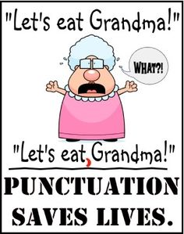

Slide 2
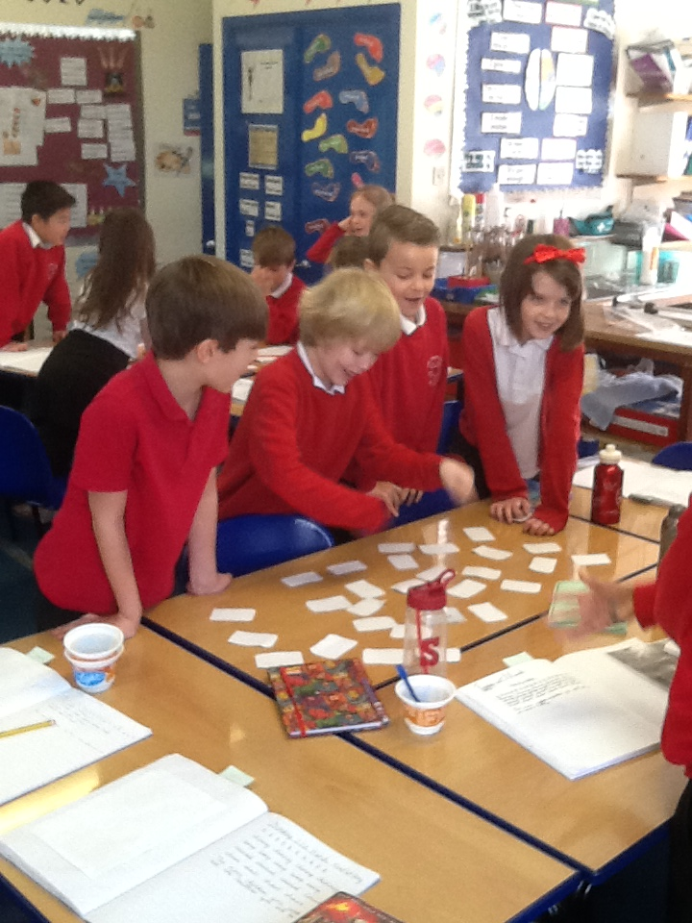
Priory Junior School
Thursday 23rd March 2017
Spelling and Grammar Evening

Slide 3
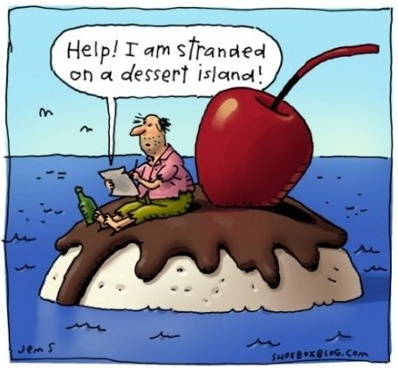
Aims of the evening
To share how spelling and grammar is taught to your children.
To suggest useful strategies you could use at home to help promote your children’s spelling and grammatical understanding.

Slide 4
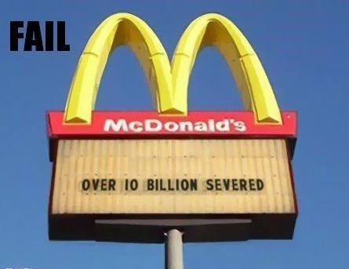

Our aim is for our children to grow up to be able to communicate effectively orally and through written form.

Slide 5
National Curriculum
In 2014 the new national curriculum was introduced throughout schools in the UK. This curriculum has a focus on all children achieving and the standards of expectations for each year group were raised.
There is now more of a focus on the learning of spelling, punctuation and grammar.
Children’s writing is closely assessed by their class teacher for development across these areas.
In year 6, the children will also sit a SAT paper for grammar and one for spelling which will provide an indication as to whether each child is working at, working towards or working at greater depth for their year group.

Slide 6
What is the purpose of weekly spellings?
The main aim is to help children spell correctly in their independent writing. This involves children converting spelling patterns to their long term memories. The more time spent learning spellings, the more likely the children are to remember these for the long term.
Research has shown that most people can remember up to 7 items in any one time and that focusing on repeated written, oral and visual exercises will convert information to long term memory.
Each week, class teachers deliver lessons according to a spelling pattern or a rule. The spellings sent home directly link to the words explored in class. Sometimes they may send home a list of words from the statutory word list. (You can find a copy of these words in your child's log book).

Slide 7
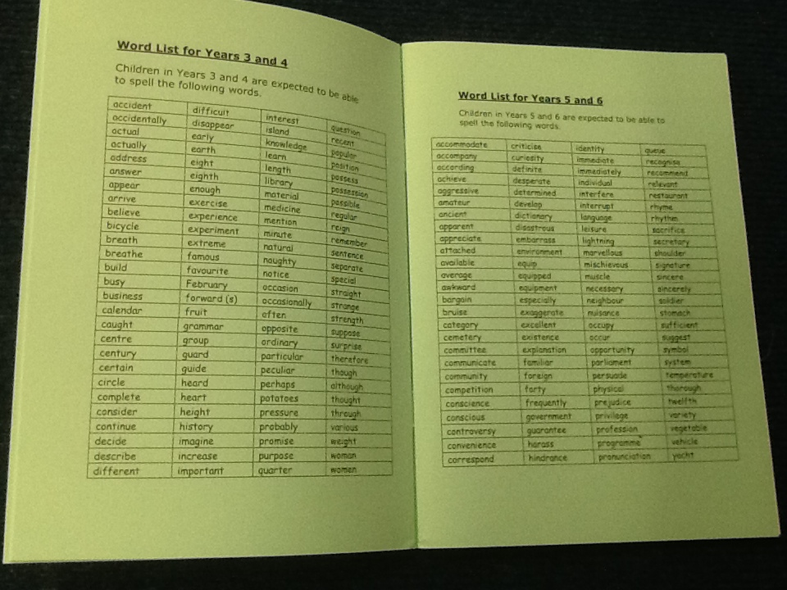
How are spellings taught in school?

Slide 8
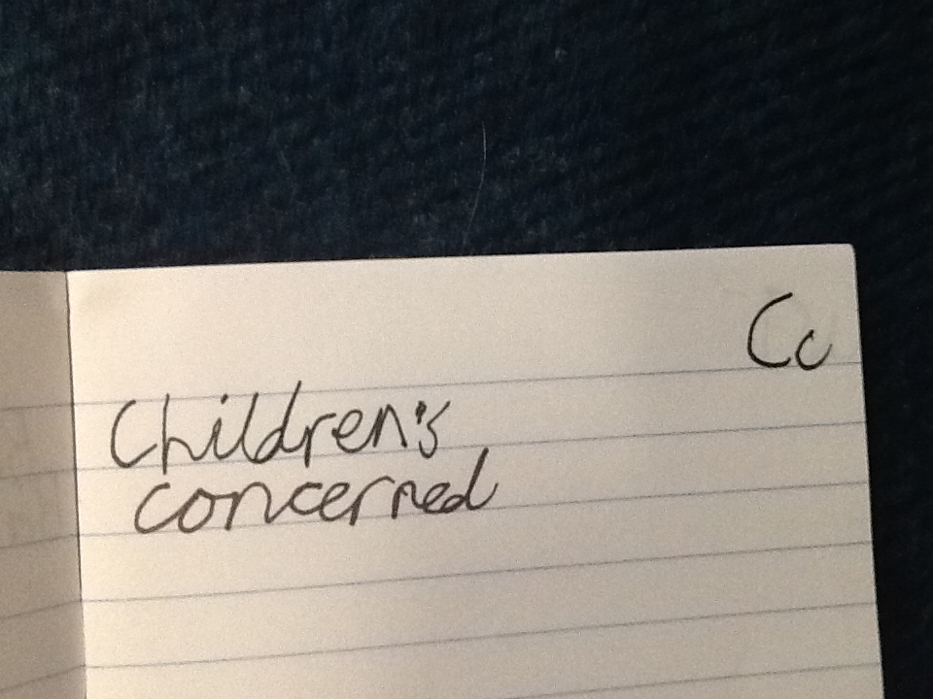
How are spellings taught in school?
The children take part in daily activities (involving oral, written and kinesthetic games/activities) where the weekly spelling rule/pattern is explored.
The children are encouraged to remember and apply the spelling rules and use these in their own writing. Any challenging words can be attempted in their 'have a go' books and then checked in a dictionary and/or with the class teacher.

Slide 9
Top Tips to convert spellings to long term memory.
Regular- the more occasions spent learning the better.
Use a range of written, oral and kinesthetic methods to learn spellings.
Support your child to play a range of games with their spelling words.
Make it fun!

Slide 10
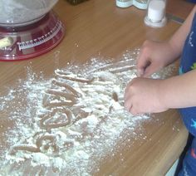
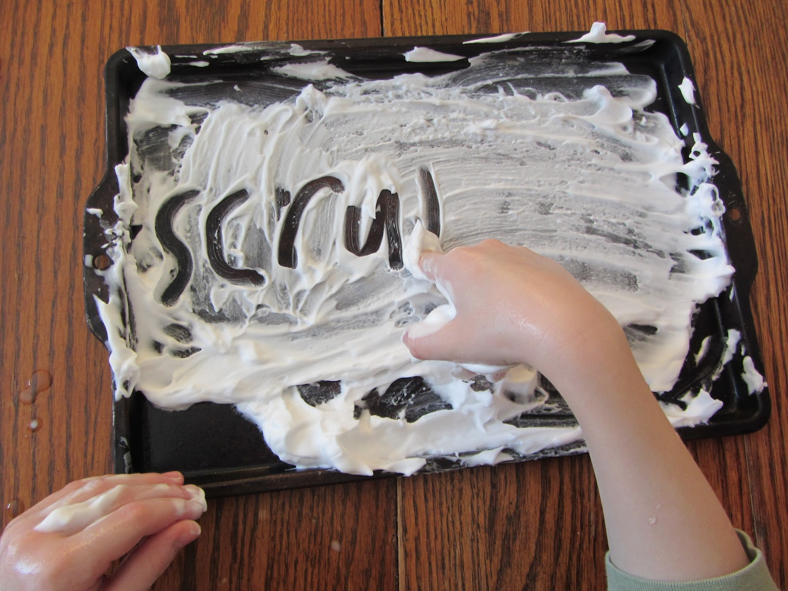
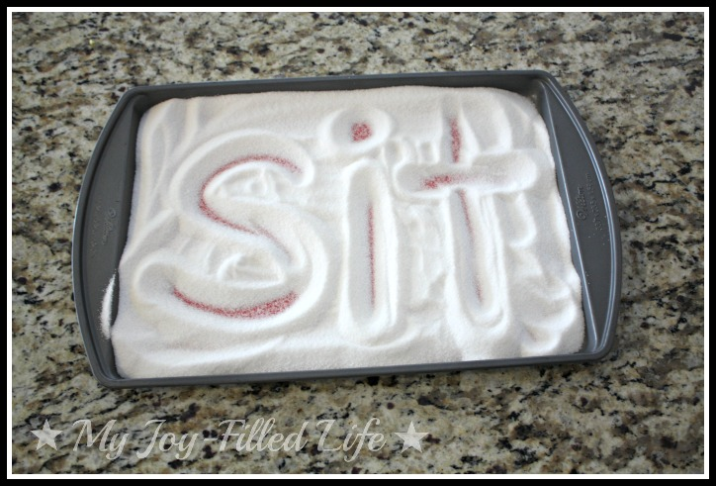
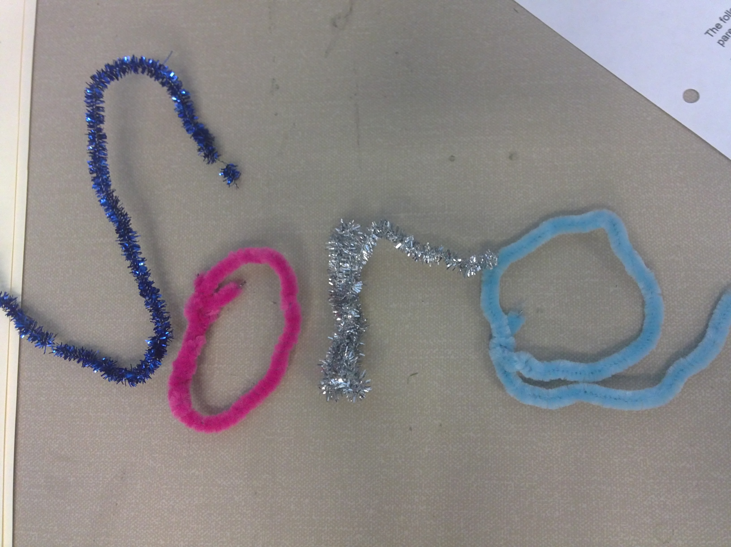
Learning spellings can be fun!

Slide 11
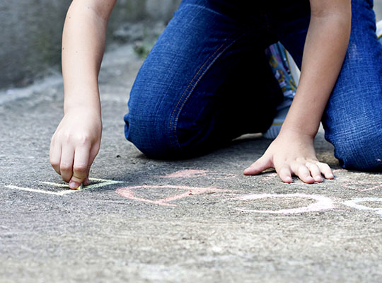
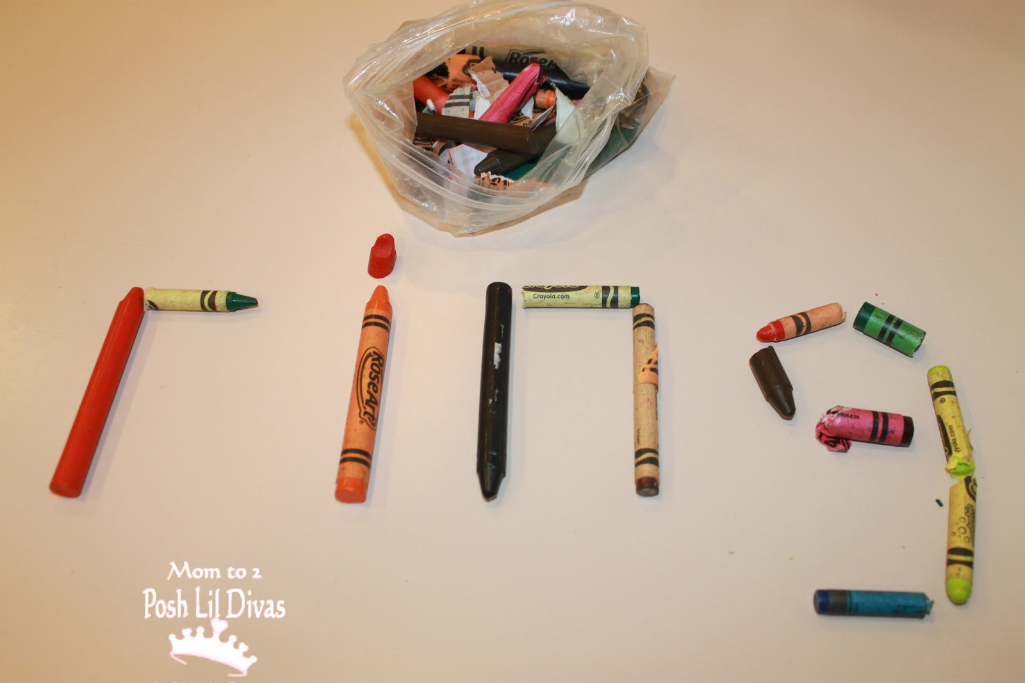
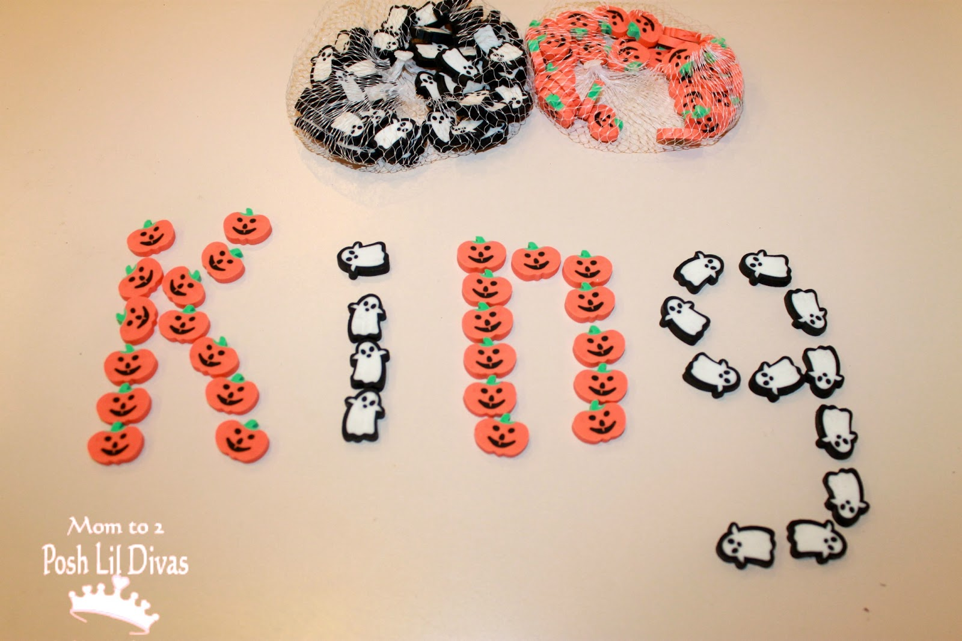
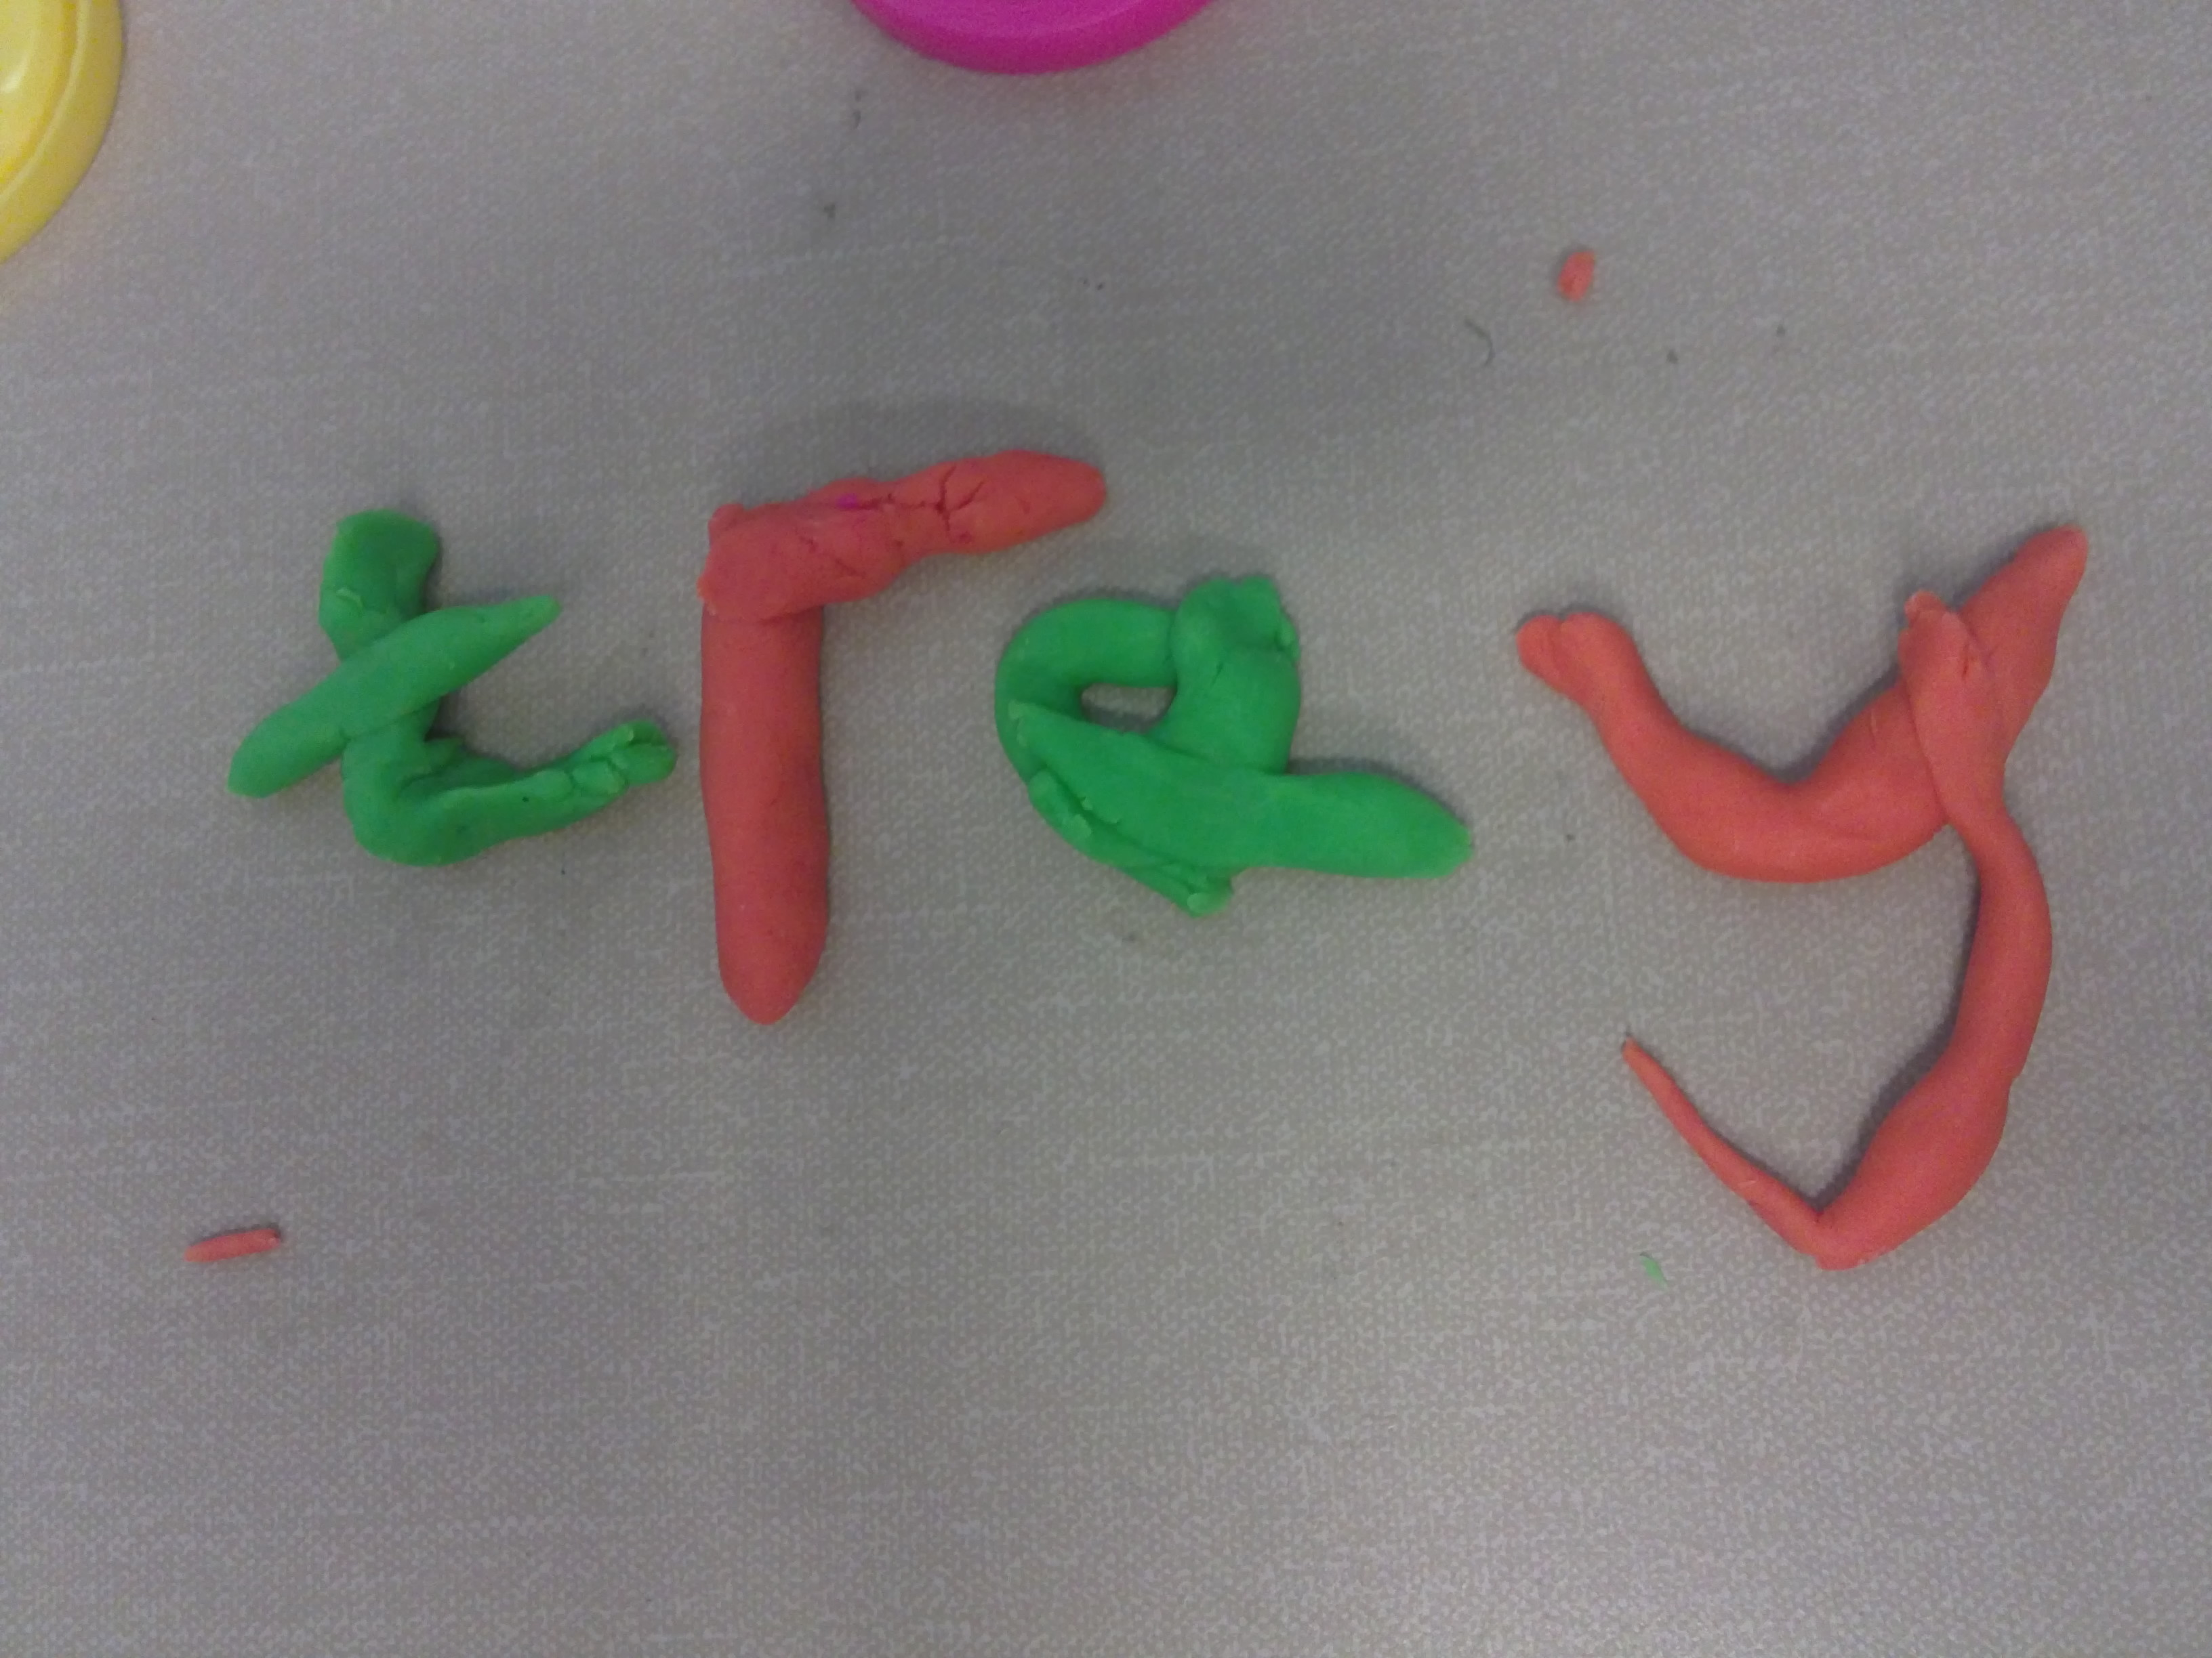
Learning spellings can be fun!

Slide 12
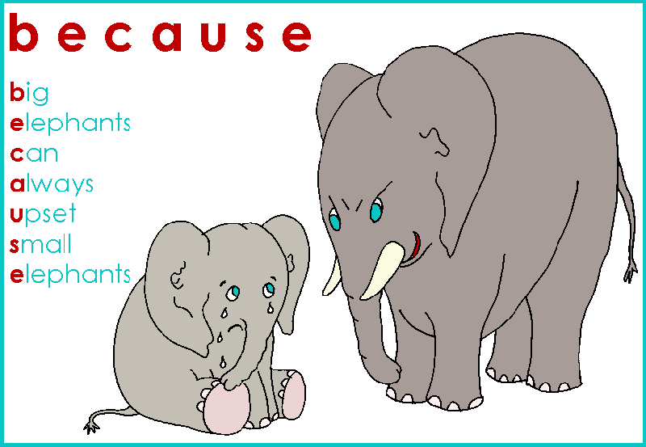
Mnemonics

Slide 18
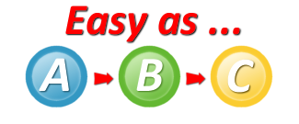
Adult sounds A,B,C,D etc
Baby sounds a,b,c,d,e,f
Vowels - A,E,I,O,U.
Part time vowel – y because it often takes on the e sound in words e.g., party

Slide 19
Why are vowels so important?
The vowels are very important because they break a word down into separate sounds- we call these sounds syllables.
You can work out how many syllables (vowel sounds) there are in a word by placing a hand beneath your chin when you say the word aloud.
A useful strategy is to encourage your child to segment each word into syllables using different colour pens.
Hen Snor kle Spag het ti
Snor kle Spag het ti

Slide 20
Phonemes = the name given to the sound.
Grapheme= is the name for the written letters which represent a sound.
There can be many different graphemes for one singular sound.
tree
sea
pony
donkey
theme

Slide 21
To be able to spell a word you need to be able to read it first
To be a successful speller involves listening to the sounds, reading fluently and comprehending the meanings of the words. For some this comes as a second nature for others it requires more effort.
It is important that children focus on the different sounds the letters are making when they read.
Sometimes children manage to read a word aloud correctly, making the right sounds simply by applying their semantic knowledge and the context of the sentence.
Therefore it is important to encourage your child to focus on the sounds which form a word. You can help your child identify the sounds through asking them to close their eyes and listening carefully to you as you say the word aloud. Ask them to identify how many syllables were in the word and what they think the corresponding graphemes are.

Slide 22
When we read we only look at the first and last letter of a word- this makes learning spellings a challenge.
I cnduo't bvleiee taht I culod aulaclty uesdtannrd waht I was rdnaieg. Unisg the icndeblire pweor of the hmuan mnid, aocdcrnig to rseecrah at Cmabrigde Uinervtisy, it dseno't mttaer in waht oderr the lterets in a wrod are, the olny irpoamtnt tihng is taht the frsit and lsat ltteer be in the rhgit pclae. The rset can be a taotl mses and you can sitll raed it whoutit a pboerlm. Tihs is bucseae the huamn mnid deos not raed ervey ltteer by istlef, but the wrod as a wlohe. Aaznmig, huh?

Slide 23
Your brain doesn’t read vowels!
As long as the first and last letter is there you can read a word- the brain looks at the layout/pattern of letters.
This makes learning spellings a little bit of a challenge. The key is to get the children to focus on the sounds (syllables) which make up each word.
Write out the weekly spellings and ask your child to segment the word into sounds by cutting the word into pieces. You could then lay these sounds out on the table top. Muddle them up. Set a timer. How many words can your child make?
Activity 1

Slide 24
Baby vowel or adult vowel?
If the vowel is followed by a letter then the baby is protected by a blanket so it will make a baby sound. If there isn’t a letter following the vowel the vowel makes the adult sound.
Tree – no letter following the vowel so it is an adult.
Tramp – there is a letter after the vowel so it is being protected by that letter. This letter is the blanket so it is a baby vowel.
Odd word that doesn’t follow the rule.

Slide 25
72 common sounds in the English language
Rhyming Tennis
Pick a grapheme sound e.g., ain and take turns to call out a word that has that pattern in it.
Each child calls out the word, speed writes it down and spells the word aloud in adult letters and the syllable sounds. The aim is to keep going until your opponent can no longer think of a word.
Activity 2

Slide 26
Odd one out game
Missing letter games
S_ _ p
Wos
Woz
Whas
Was
What letters could you put in the gap?
Stamp
Steep

Slide 27
Missing letters.
What is missing from the gap?
s_ _ prise
p_ _ chase
_ _ gent
f _ _ niture
s_ _ vive
p_ _ pose

Slide 28
Which could fill the gap?
Th _ _ st
ur ir er ear
Word detective (words within words)
goldfish whisper friend
gold old fish his end

Slide 29
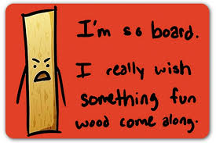
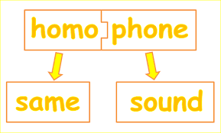
Which witch was it?
Here and Hear Hear has an ear in it!
Witch and which
Witch has itch in it so this means this word is a real living person.

Slide 30
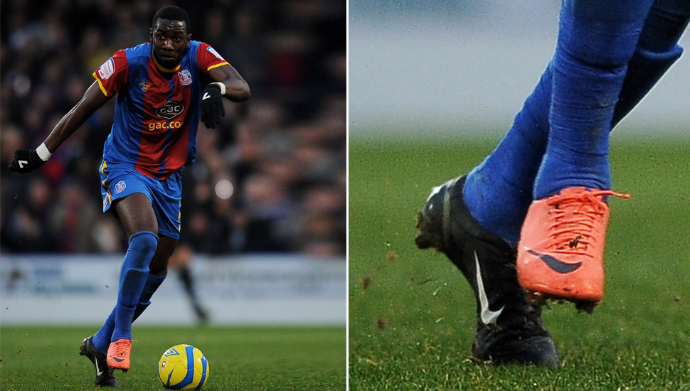
Funny sentences for homonyms
-same sound, same spelling but different meaning
His boots didn’t match whilst playing the match.

Slide 31
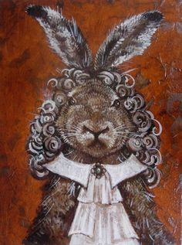
Funny sentences for homophones
- same sound but different spelling and meaning.
The hare had curly hair.

Slide 32

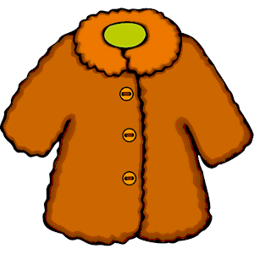
Snap and Pairs
Where are you going?
Wear your coat.

Slide 33
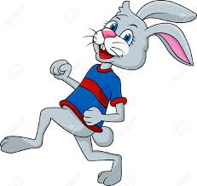

Snap and Pairs
Hare
Hair.

Slide 34
Word Blocks
Draw a grid containing no more than 9 letters. You will need at least one vowel.
The object of the game is to make as many words as possible.
S | T | P
A | O | L
B | M | R

Slide 35
Adding suffix ing to verbs
Move-moving
Shove- shoving
Change- changing
Come- coming
Love- loving
What is the rule?
Remove the e and add ing.

Slide 36
Double the final consonant after a baby vowel and add ing.
Hop – hopping
Slip- slipping
Tap – tapping
Step-stepping
Shut- shutting

Slide 37
ly and root words
It’s simple all you have to do is keep the root word the same and add ly!
lone + ly = lonely
real + ly = really
soft + ly = softly
careful + ly = carefully
But there is of course some exceptions to the rule!
gentle - gently

Slide 38
Spot the mistakes!
How many mistakes have I made?
1. cruely
2. softly
3. badley
4. carefully
5. hopelessly
6. realy

Slide 39
Changing a y to an i before adding the suffix.
If the y is on its own in a word (it doesn’t have one of the vowels next to it) then we change the y to an i. Then we add the suffix.
lady ladies baby babies
happy happier

Slide 40
What if a y is next to a vowel?
If the y is next to a vowel then you just add the suffix.
play playing play player
play plays play playful

Slide 41
However there is an exception to the rule…
If the suffix starts with an ‘i.’ For example adding ‘ing’.
marry marrying
we do not change the y for an I

Slide 42
i before e except after c
‘i’ before ‘e’ except after ‘c’
thief chief
deceived received ceiling
only if it makes the ‘ee’ sound
because look at … height – weight etc

Slide 43
able or ible
They have the same meaning (able to).
If the root word is complete you add able
If the root word is incomplete you add ible.
Like = full word = add able = likeable
Poss = incomplete word = add ible = possible.

Slide 44
Magic e
When the letter e is one letter away from a single vowel it changes the sound of that vowel from a baby sound to an adult sound.
E.G. Hope - the o is the adult sound because the magic e is one letter away from the vowel.
In ‘Hopped’ the e can not work because it is too far away from the vowel so the o is a baby sound here.

Slide 45
One l or two?
Words of more than one syllable
rarely end in double ‘l’
beautiful until fulfil
thoughtful cheerful awful
unless they are compound words
Football

Slide 46
Researching suffix and prefix
Research the meaning of different prefixes and suffixes.
How do they change the meaning of the root word?
Activity 3 and 4

Slide 47
Games to play with prefixes and suffixes
The aim of the games below is to match up the root word with the correct prefix or suffix to make a word:
Dominoes
Snap
Pairs
Treasure Hunt
Spelladrone

Slide 48
Grammar
Grammar teaching helps the children to understand how to form complete sentences.
It also helps them to manipulate the structure of sentences to create a variety of different sentence types.
Your child’s writing will be assessed according to the criteria for each year group and they will sit a test for grammar in year 6.

Slide 49
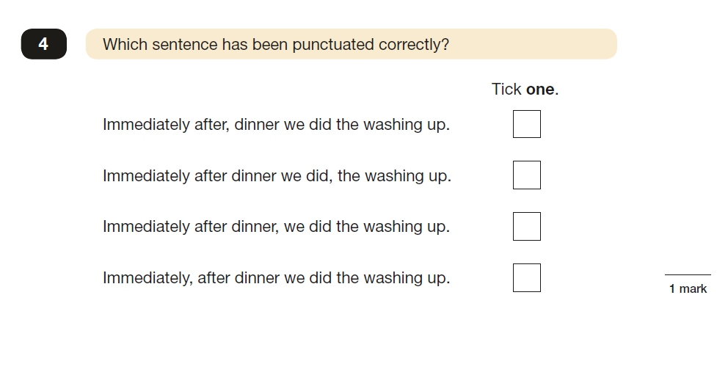
Key Stage 2 Grammar Test

Slide 50
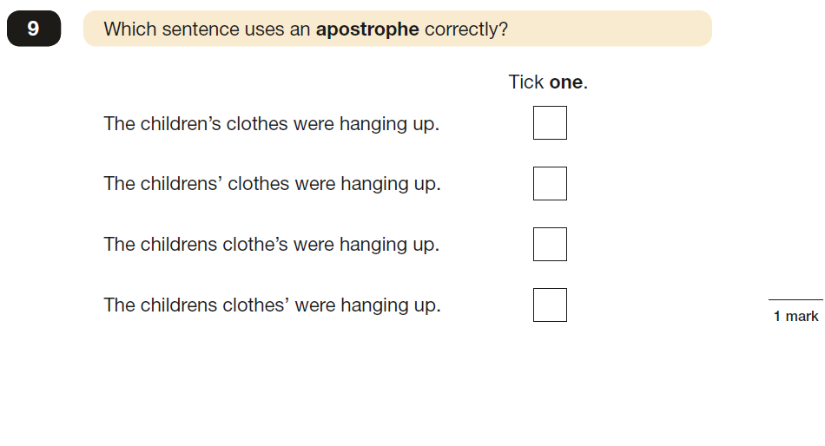

Slide 51
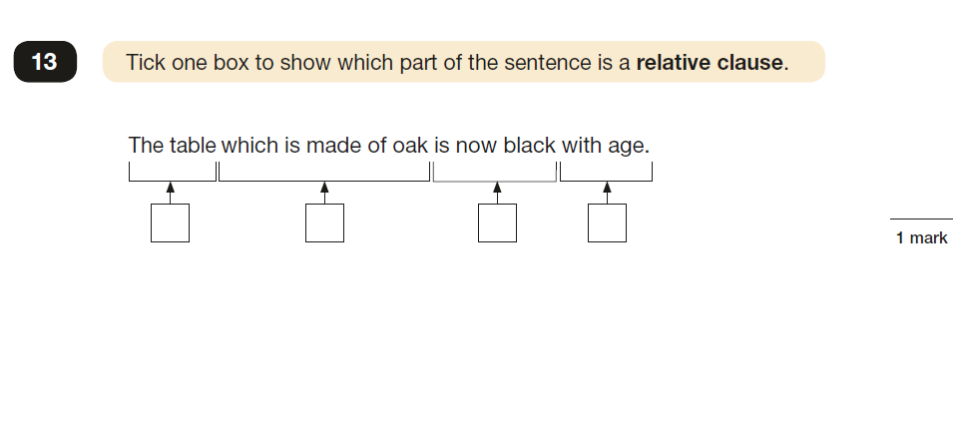

Slide 52
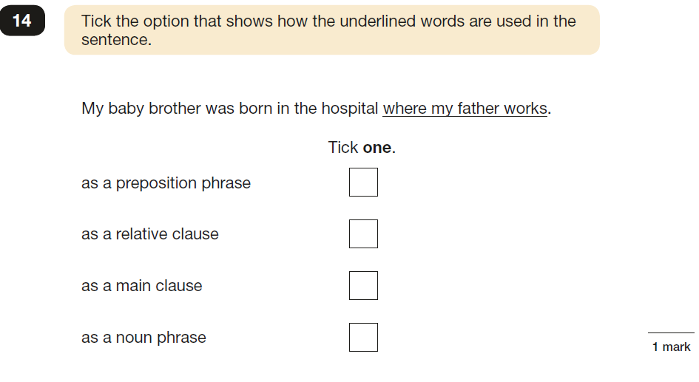

Slide 53
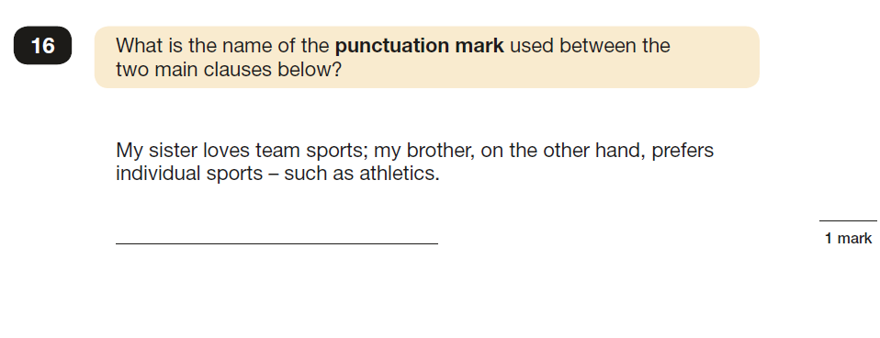

Slide 54
How we teach grammar at Priory Junior School
Quick activities on the whiteboard.
Games.
Embedded into the English lessons.
Sentence of the week.
Kung-fu punctuation activity

Slide 55
How you can help…
Use the sentence types at home.
Explore the British Council website to revise year group appropriate activities.
Kung –Fu punctuation.
Sentence starter games.
Complex sentences games.

Slide 56
Websites
https://uk.ixl.com/promo?partner=google&campaign=1715&adGroup=mathinenglish.com&gclid=CKPope2K49ICFQoo0wodRHQPAw
http://www.theteachersguide.com/prefixessuffixesworksheets.htm
http://www.k5learning.com/free-flashcards/reading/prefix-suffix
Upper years
http://resources.hwb.wales.gov.uk/VTC/2011-12/english/reading-games/antonym-splat/index.html
http://www.learninggamesforkids.com/vocabulary-games/antonyms/antonym-or-synonym.html

Slide 57
