Slide 1

Year 4
2026 - 2027
Welcome to the Year 4 Meet and Greet
Notes:
Emily

Slide 2
Staff in Year 4
NT4 – Miss Turner
Additional staff – Miss Purser, Mrs Bourke and Mrs Brock
HR4 – Mrs Harper and Mr Righetta
Additional staff – Mrs Tester
Focus Group: Mrs Bourke and Mrs Freeman.
Notes:
All introduce ourselves and TAs in classes

Slide 3
What to bring every day?
Healthy snack – fruit or vegetables (no nuts please)
Home-school book
Reading book
PE Kit – bring in on a Monday and take home on a Friday
No make up, nail varnish or jewellery (small stud earing in each ear which will need to be taken out for PE; this is a county rule).
Outdoor clothing – waterproofs, wellies and spare change of clothes.
Notes:
Emily

Slide 4
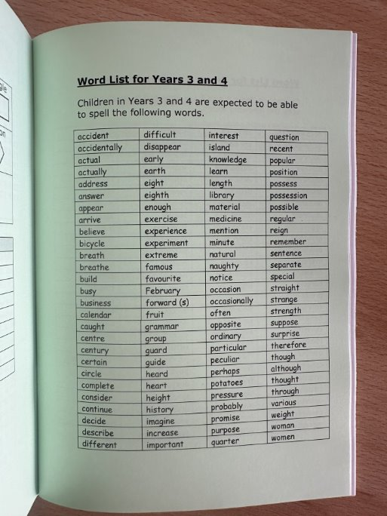
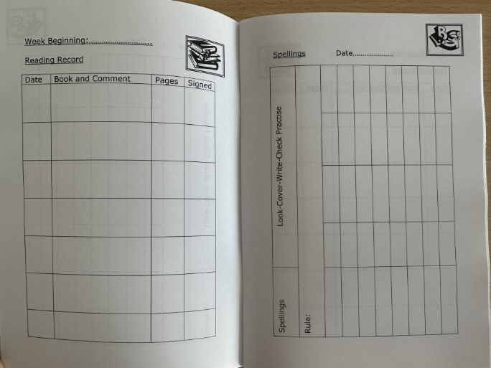
Homework
Spellings
Set each Wednesday
The children will be given a spelling list each week which reflects the spellings they are practising in school.
They need to practise their spellings each week.
Reading
The children need to record when they've
read in their reading record.
The aim is to be reading most days for at least 10 minutes.

Slide 5
Homework
Learning Log Books
Homework will be set on a Wednesday and due on a Monday.
A task relating to one of our topics will be stuck into their Learning Log and they can complete it over the double page. This will hopefully be creative and engaging for the children.
We will be setting homework on Mathletics every other week. A maths sheet will be provided for the other weeks.
When maths is a paper worksheet, this will be stuck in their Learning Log.
This will start next Wednesday (16th).
Notes:
Emily

Slide 6
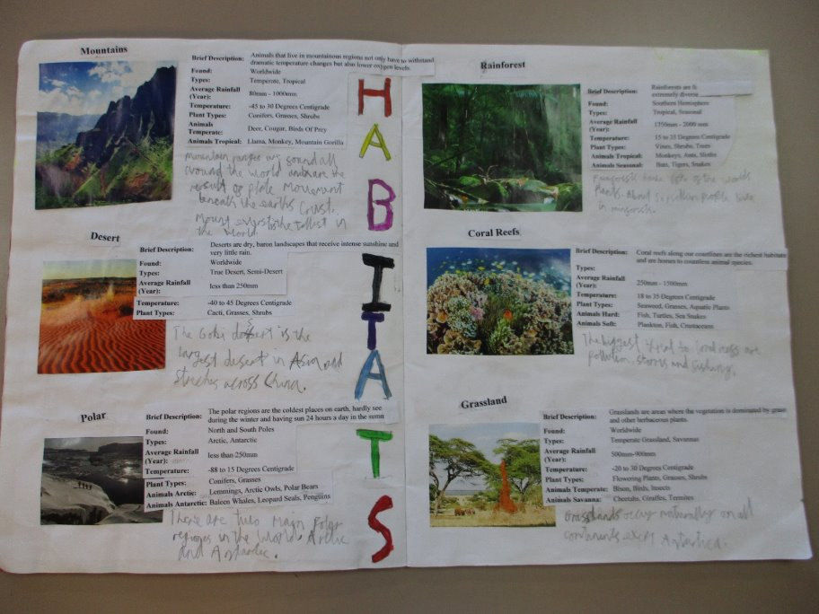
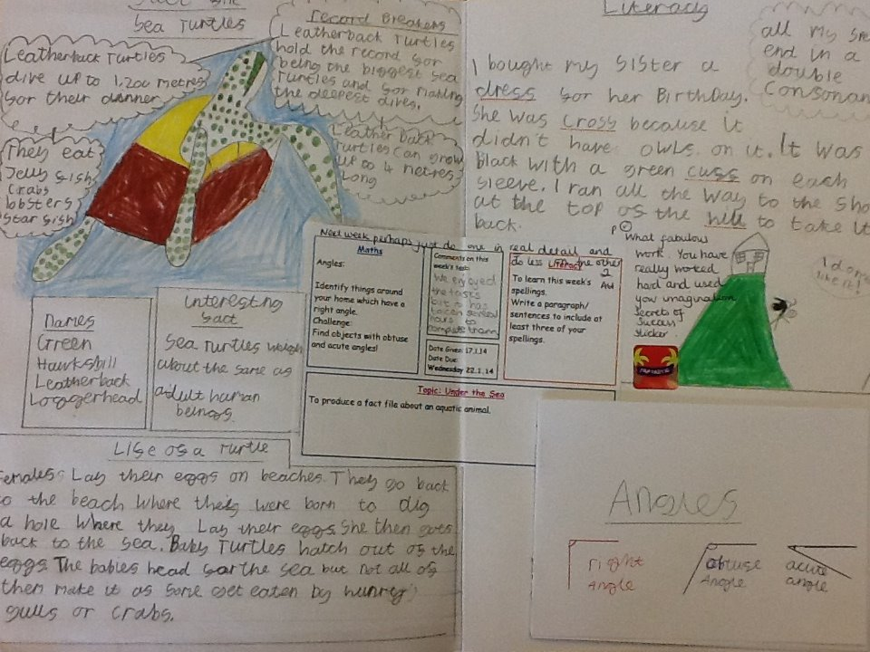
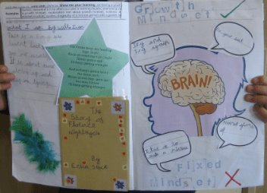
Homework
Notes:
Emily

Slide 7
Homework
Times tables
The children will be taking their multiplication check in June 2027. This is a national assessment that all Year 4 pupils do online.
The best way to improve recall is to practise on TTRS. The soundcheck option replicates what the children will experience in this assessment.
The children need to be practising on TTRS every day. We will do this in school but children who practise at home tend to achieve great results. Please speak with us if technology at home is a barrier.
In school, children will be learning and practising times tables every day in class.
Being able to confidently recall all times tables and related division facts up to 12x12 will significantly aid confidence and progress in maths.
Notes:
Emily

Slide 8

Autumn 1
English – The Egyptian Cinderella
Maths
Science – Electricity
History – Ancient Egypt
Art – Death Masks
DT – Torch making
Music – Abba
French
RE – Special Books
Computing - Scratch
PE – Pilates and OAA
Notes:
Alex

Slide 9

Autumn 2
English – The Butterfly Lion
Science – Living Habitats
Geography - Africa
Art - TingaTinga
French
Maths
Music – African Drums
Computing – Blogging and Film Making
DT - Torches
RE – Symbolism of Light
PE – Dance and Net Games
Notes:
Alex

Slide 10

Spring 1
English – Escape From Pompeii
Science – Sound
History - Romans
Computing – Data Loggers (Sound)
Art – Mosaics
DT – Food
RE – New Year Traditions
PE – Haka
French
Maths
Music
Notes:
Tom

Slide 11

Spring 2
English – The Incredible Book Eating Boy
Science – Digestion and Teeth
History - Romans
Computing - Scratch
Art – Drawing
DT – Bread
RE – Easter
PE – Gymnastics and Net
French
Maths
Music – Lean on Me
Notes:
Tom

Slide 12

Summer 1
English – Fox
Science – States of Matter
Geography – Mountains and Natural Disasters
Art – Printing
DT – Pneumatics
RE – Prayer
PE – Hockey and Athletics
French
Music – The Beatles
Computing – Comic Life
Maths
Notes:
Tom

Slide 13
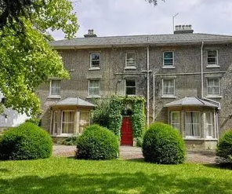
Burwell
2 nights and 3 days.
There will be a letter in the next few weeks to give more information.
Please do not worry!
Every child (even those who were worried) always come back excited and full of funny stories.
We will work with you to help you and your child prior to the trip.
Notes:
Tom

Slide 14

Summer 2
English – James and the Giant Peach
Science – STEM Project
Geography – Italy
Art – Quentin Blake
DT – Making an interactive toy
RE – Prayer
PE – Net games and striking and fielding
French
Maths
Music – composing music
Computing – Collect and Handle Data
Notes:
Tom

Slide 15
Coming up....
Harvest Assemblies – 7th October
Ancient Egyptian Day – 21st October
OPAL Parent Do Day – 19th October
Burwell Residential – Summer Term 1
HR4's Class Assembly – Summer Term 1
NT4's Class Assembly – Summer Term 2
Notes:
Alex

Slide 16
Thank you for listening!
We are looking forward to working with you.
Please feel free to visit your child's classroom.
We will be around if you have any questions.
Notes:
Tom

