Slide 1
Computing in the Curriculum

Slide 2
What the national curriculum says
Key stage 2
Pupils should be taught to:
design, write and debug programs that accomplish specific goals, including controlling or simulating physical systems; solve problems by decomposing them into smaller parts
use sequence, selection, and repetition in programs; work with variables and various forms of input and output
use logical reasoning to explain how some simple algorithms work and to detect and correct errors in algorithms and programs

Slide 3
What the national curriculum says
understand computer networks including the internet; how they can provide multiple services, such as the world wide web; and the opportunities they offer for communication and collaboration
use search technologies effectively, appreciate how results are selected and ranked, and be discerning in evaluating digital content
select, use and combine a variety of software (including internet services) on a range of digital devices to design and create a range of programs, systems and content that accomplish given goals, including collecting, analysing, evaluating and presenting data and information
use technology safely, respectfully and responsibly; recognise acceptable/unacceptable behaviour; identify a range of ways to report concerns about content and contact.

Slide 4
The Strands of Computing
Computing in our school is divided into 5 strands:
Programming
Data Handling
Multimedia
Technology in our lives
E-safety

Slide 5
Programming
Why is coding important:
It can improve organisation skills
It can help children visualise abstract concepts
It can build resilience
It can lead to jobs that haven’t even been invented yet!
Let’s Code!

Slide 6
Data Handling
Why data handling is important:
It allows children to present information
It allows children to develop their reasoning skills
Children can use data handling to further their questioning skills
It is used across a variety of other subjects such as maths, science and even P.E.

Slide 7

Multimedia
Why is multimedia important:
It is extremely creative
It develops English skills
It develops personal and social skills
It allows children to learn skills needed for creative industries.

Slide 8
Technology In Our Lives
What is Technology in our lives:
It teaches children web based skills
It allows children to understand the unwritten rules of the Internet
It gives children a platform to discuss problems or skills
It teaches children skills to recognise misleading or false information

Slide 9

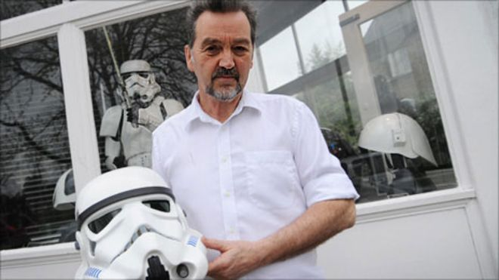
Technology In Our Lives
VS
George Lucas
Andrew Ainsworth

Slide 10
E-safety
Why e-safety is important:
It allows children to recognise when they feel unsafe online
It allows children to know what to do when they feel unsafe online
It gives children to confidence to speak out
It is not just about Cyber Bullying…

Slide 11
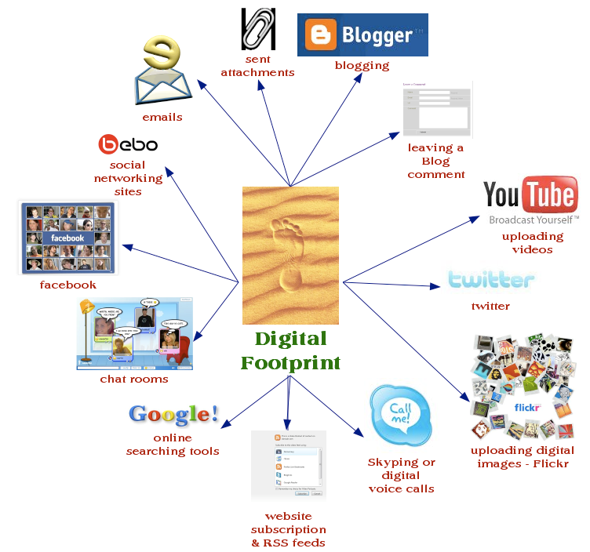
How Big Is your Digital Footprint?
How much data do you think you have given away this week?
Write down on the sugar paper where you have given someone your details.

Slide 12
Any Questions?
Thank you all for coming this evening

