Slide 1
Burwell RESIDENTIAL TRIP
March 2024

Slide 2
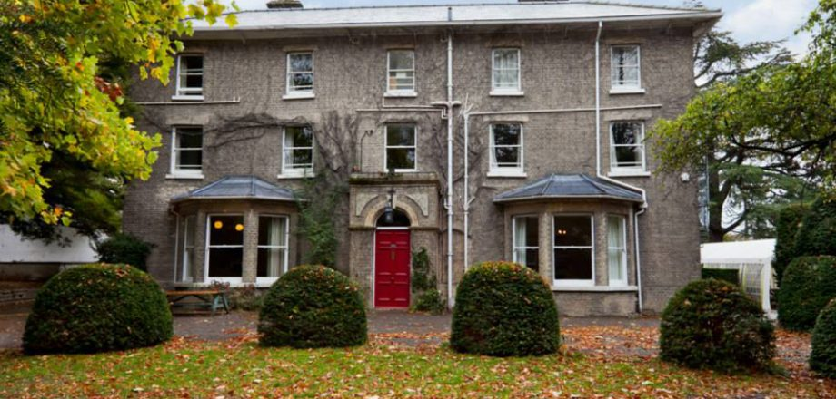
Burwell House
Modernised 18th century house in 3 acres of landscaped gardens- perfect for the outside explorer.
Holds the Council for Learning Outside the Classroom Quality Badge.
Can accommodate up to 56 pupils including staff.
Only one school in residence at any one time.
Qualified teachers create a timetable to fit in with your child’s learning at school whilst providing a fun, enriching experience.
Offers lots of secure space for children to explore and develop independence.

Slide 3
Aims of the trip
For children to take part in fun outdoor, adventurous activities guided by instructors as well as their teachers.
To experience staying over in a new place away from home.
To have new experiences and learn new skills.
To build trust and team work within the year group.
To develop resilience when faced with a challenge.

Slide 4
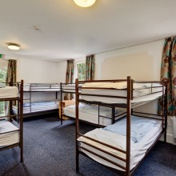
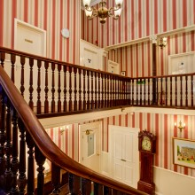
Accommodation
Children will be placed in rooms with friends – they have been asked to name up to three friends they would like to share with, and we will ensure they are with at least one of these people.
Children will be told which room they will be staying in when they arrive.
Dietary requirements will be sent to Burwell to ensure all children are catered for. They will receive three healthy meals per day.

Slide 5
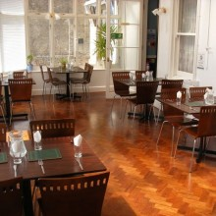
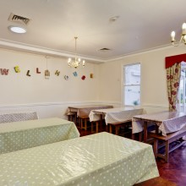
Dining
Plenty of delicious home-cooked food prepared by their fantastic catering team.
Hot breakfast – and a selection of cereals, toast & preserves and fruit.
Hot cooked lunch with pudding
Hot cooked dinner with pudding
Fruit snacks throughout the day and water is always accessible.

Slide 6
Health and Safety at Burwell
LOTC Quality badge
Clear safety procedures in place.
All staff are briefed on arrival.
Children will complete a fire drill on arrival.
Children are briefed before activities.

Slide 7
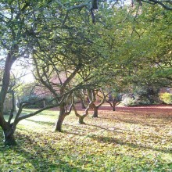
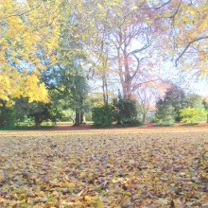
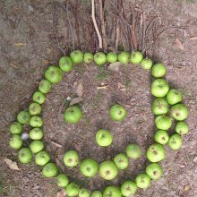
Activities
Snail Game
Map walking
Smugglers Mystery
Low Ropes
Eggscape – Team challenge
Fire lighting / Shelter building
Orienteering Challenge
Burwell Fox

Slide 8
Kit List
A robust, reusable drinks bottle of a reasonable size. (500ml).
Warm pyjamas with socks.
Indoor shoes – (not slippers)
A warm hat, gloves and scarf for evening walks/activities.
A waterproof jacket.
Sensible trainers/walking boots. We will be walking long distances.
Long sleeved T-shirts (even in hot weather for specific activities).
Thick jumpers to keep your child warm.
Thinner cardigans/jumpers for layering.
DO NOT BRING any electrical devices e.g. tablets, phones etc.

Slide 9
Medical
If there are any dietary requirements the school are not aware of please let us know as soon as possible. This needs to be done via an email to the office.
If your child requires any medication throughout the trip this must be taken to the office for forms to be completed so that this can be administered appropriately during their stay.
You will receive a form where you can add any additional information about your child that you think will be relevant for the trip.

Slide 10
Departure and Arrival
The children will need to arrive to school at normal time with their kit for the 3 days.
We will return to school for collection at the usual time
AB4 + TH4 Group 1
Monday 18th – Wednesday 20th March
EL4 + TH4 Group 2
Monday 25th – Wednesday 27th March

Slide 11
Staff
Monday 18th – Wednesday 20th March
Mr Brolia
Mr Hodgkiss
Miss Purser
Monday 25th – Wednesday 27th March
Miss Lygo
Mr Hodgkiss
Miss Dean

Slide 12
Questions?

