Slide 1
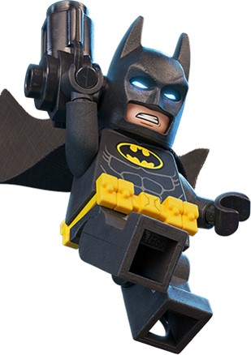
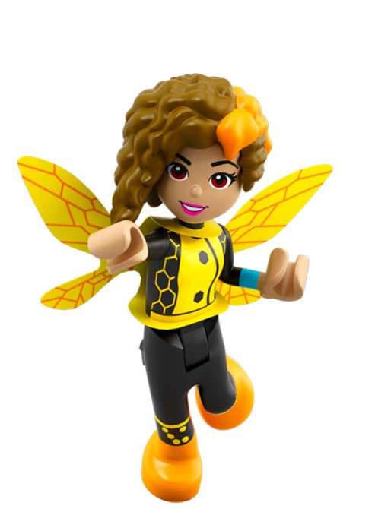
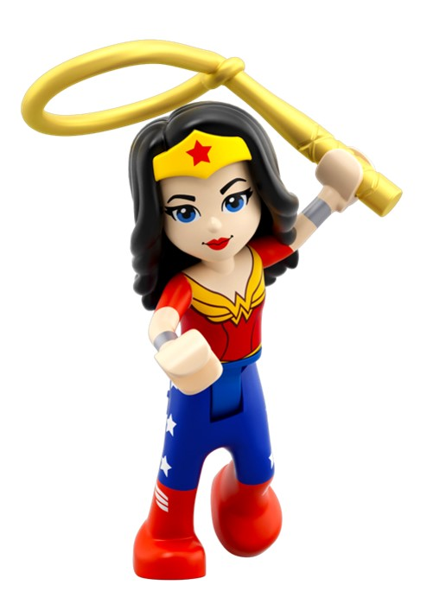
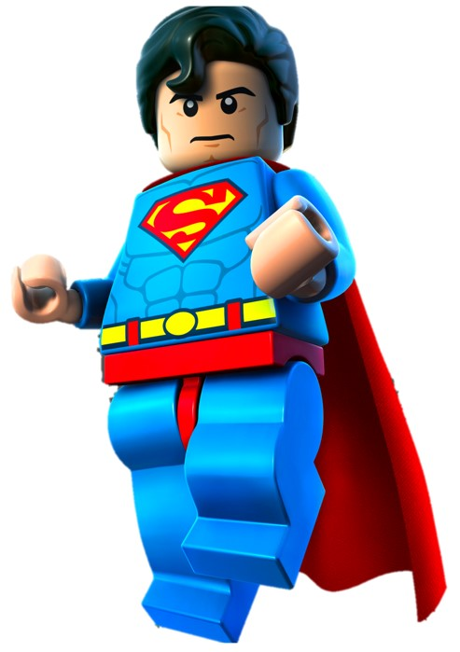
Relative Clauses

Slide 2
Relative Clauses
Relative clauses can give more information about a noun.
Bumblebee is shrunk to insect-like size.
Tell me more about Bumblebee.
Bumblebee, whose suit allows her to fly, is shrunk to insect-like size.
Bumblebee, who can unleash electric stings, is shrunk to insect-like size.
Bumblebee, who fires sonic force blasts, is shrunk to insect-like size.

Slide 3
Relative Clauses
Relative clauses can give more information about a noun.
They usually begin with a relative pronoun.
Bumblebee is shrunk to insect-like size.
Tell me more about Bumblebee.
Bumblebee, whose suit allows her to fly, is shrunk to insect-like size.
Bumblebee, who can unleash electric stings, is shrunk to insect-like size.
Bumblebee, who fires sonic force blasts, is shrunk to insect-like size.
Relative Pronouns
who, which, where, when, whose, that

Slide 4
Relative Pronouns
Relative pronouns relate the clause to the noun.
Batman, whose name is Bruce Wayne, wears a special suit.
Batman wears a special suit which protects him from enemies.
He lives in Gotham City where he fights crime and criminals.
Relative Pronouns
who, which, where, when, whose, that

Slide 5
IDEAS
Relative Clauses
Try adding a relative clause to this sentence.
Add information about either noun.
Start it with a relative pronoun.
Tell me more about Wonder Woman or her bracelets.
Wonder Woman wears a pair of metal bracelets.
Wonder Woman, who won’t back down from a challenge, wears a pair of metal bracelets.
Wonder Woman wears a pair of metal bracelets that provide her with protection.
Relative Pronouns
who, which, where, when, whose, that

Slide 6
IDEAS
Relative Clauses
Try adding a relative clause to this sentence.
Add information about a noun.
Start it with a relative pronoun.
Tell me more about Wonder Woman or her bracelets.
Wonder Woman wears a pair of metal bracelets.
Wonder Woman, who won’t back down from a challenge, wears a pair of metal bracelets.
Wonder Woman wears a pair of metal bracelets that provide her with protection.
Relative Pronouns
who, which, where, when, whose, that

Slide 7
Punctuating Relative Clauses
When the relative clause comes after the main clause,
we do not usually separate the clauses with a comma.
main clause
relative clause
Wonder Woman raised her arm that was protected by her bracelet.
A comma would create an unnecessary break in the sentence.

Slide 8
Punctuating Embedded Relative Clauses
Sometimes the relative clause is embedded in the main clause.
main clause
Superman shouted at Batman.
The relative clause needs to be next to the noun: Superman.
Tell me more about Superman.

Slide 9
Punctuating Embedded Relative Clauses
Sometimes the relative clause is embedded in the main clause.
main clause
main clause
Superman, who was a sheepdog, shouted at Batman.
Tell me more about Superman.
The main clause splits to make space...

Slide 10
Punctuating Embedded Relative Clauses
Sometimes the relative clause is embedded in the main clause.
main clause
main clause
Superman, who was growing angry, shouted at Batman.
The main clause splits to make space...
for the relative clause.

Slide 11
Punctuating Embedded Relative Clauses
Sometimes the relative clause is embedded in the main clause.
Commas separate the clauses because the relative clause breaks up the main clause.
Superman, who was growing angry, shouted at Batman.

Slide 12
Explore more Hamilton Trust Learning Materials at https://wrht.org.uk/hamilton/ .

