Slide 1
Welcome to Year 5!

Slide 2
The Year 5 Team!
AI5 – Miss Ingle and Mrs Pietersz
EL5 – Miss Lygo and Mrs Rossin

Slide 3


Slide 4
Our Topics
Autumn 1 – Ancient Greeks – Greek Myths - Forces
Autumn 2 – Space – Leon and the Place Between – Planet Earth
Spring – Anglo-Saxons – Beowulf, You Wouldn’t Want To Be an Anglo-Saxon Peasant, Michael Morpurgo author study.
Summer 1 – Rivers – The Nowhere Emporium
Summer 2 – Sustainability – The Nowhere Emporium

Slide 5
Things Needed in School
Water bottles
PE kit on a Monday, take home on a Friday
Swim kit on Thursdays
Healthy snack – fruit or veg only (Nut-safe school – no nuts please)
Home-School books to be brought in every day along with home or school reading book, from Monday.

Slide 6
PE Days for Autumn Term
AI5 – Tuesday and Thursday (swimming)
EL5 – Wednesday and Thursday (swimming)
If for whatever reason your child can't do PE, please
let your child's class teacher know via email or
note in the home-school book.

Slide 7
PE Kit
Trainers
Red t-shirt
Black shorts or trousers
Hair tied back
No jewellery – Earrings must be removed (county rule)

Slide 8
Swimming Kit
Children need to bring a towel and swimming costume (one piece) or trunks (not board shorts).
Children can bring and wear goggles, but they may be encouraged to try without, when considering water safety.
Again, hair will need to be tied back and earrings out.
The children should bring this in a separate bag, ready to change into, in the afternoon.

Slide 9
Homework
Handed out on a Wednesday to be returned by the following Monday.
This will start Wednesday 16th September
What will my child need to do each week?
A task, relating to one of our topics, will be stuck into their Homework book and they can complete it over the double page. This aims to be creative and engaging for the children.
Maths task – This alternates between a sheet and Mathletics.
TTRS session
Daily reading
Practice spellings related to our spelling rule in their
home-school books.

Slide 10
Homework
How long should my child spend doing each task?
Aim for at least 5 minutes of TTRS every day
Aim to read for at least 10 minutes a day (an adult to sign in the home-school book). Minimum 3 times a week.
Around 30 minutes for the English-based task
Around 15 minutes for the Maths task
Home-school books will be handed in on a Monday for us to check
reading and spellings.

Slide 11
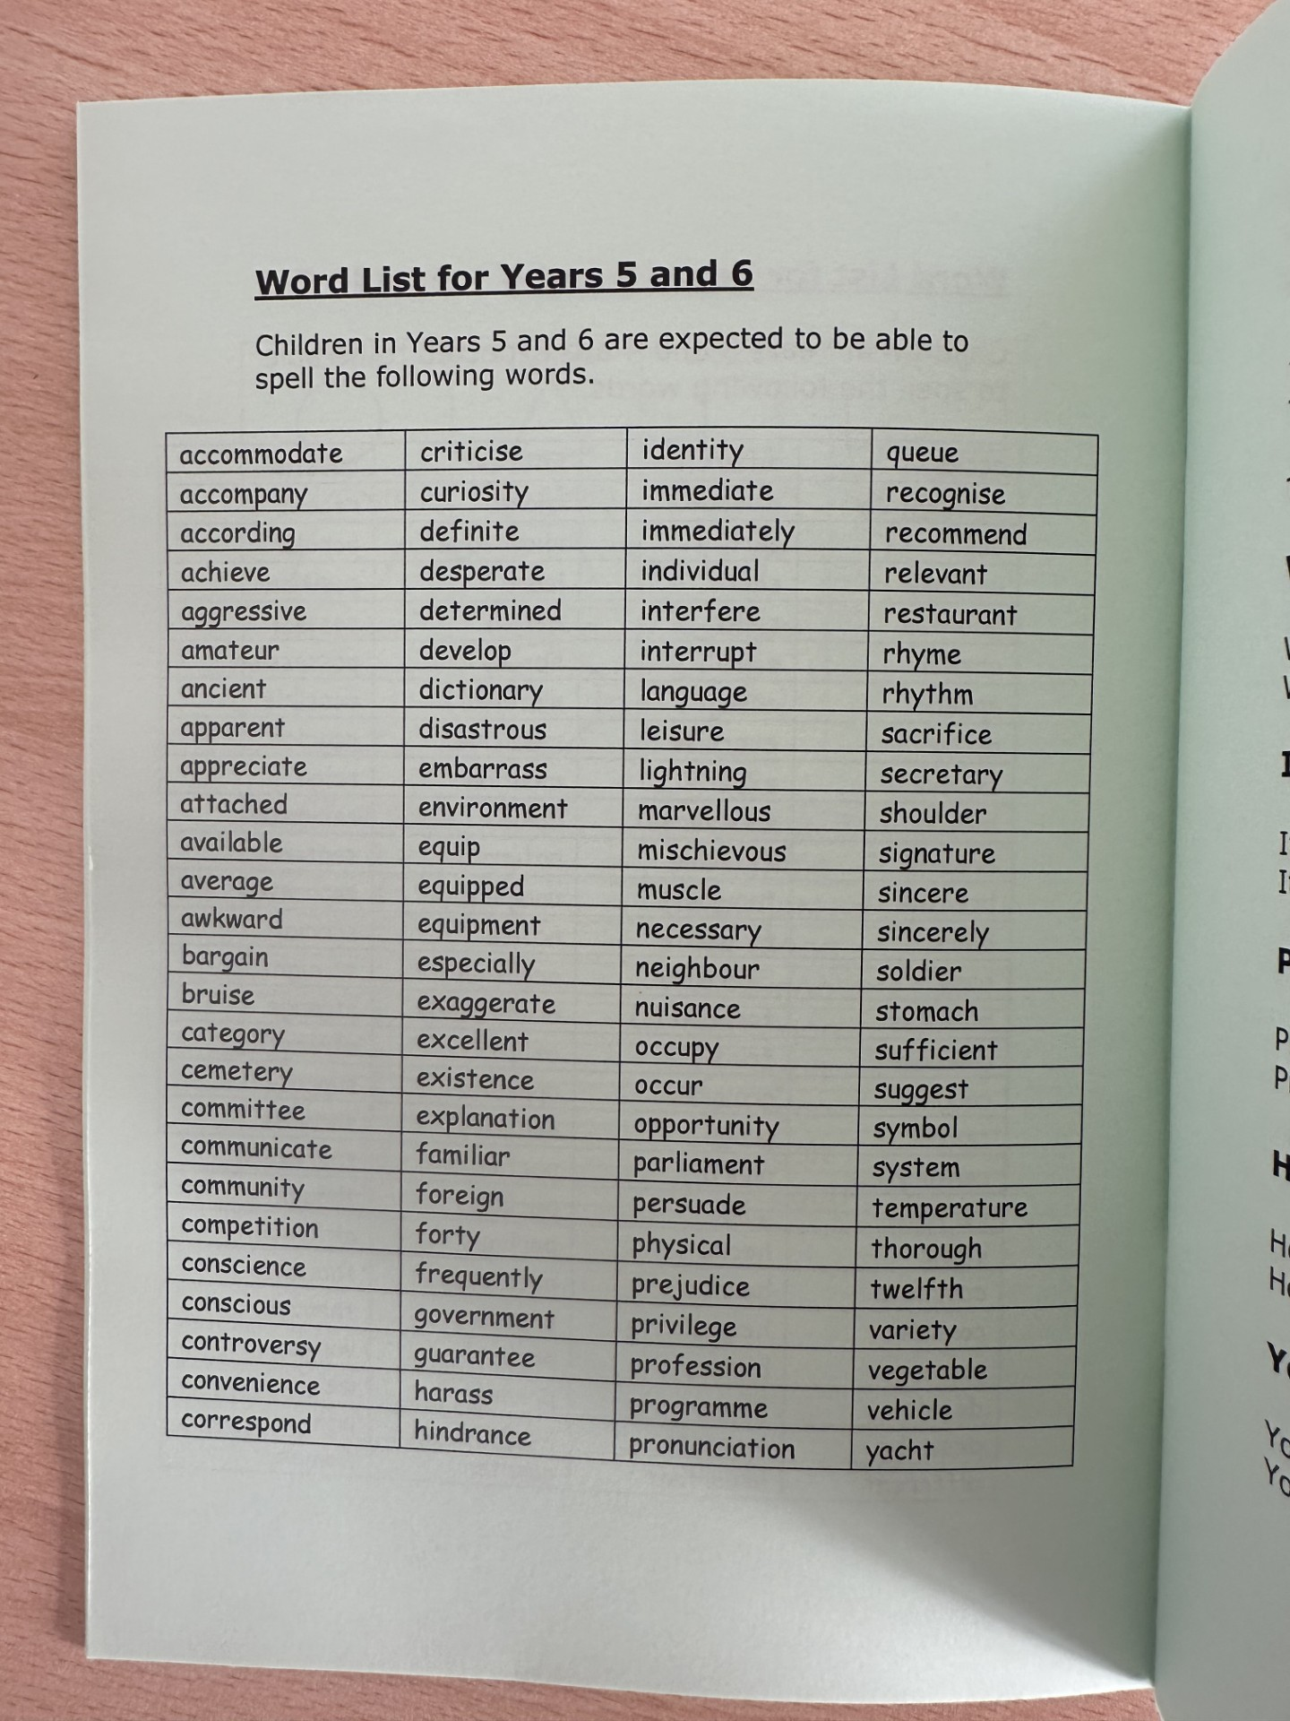
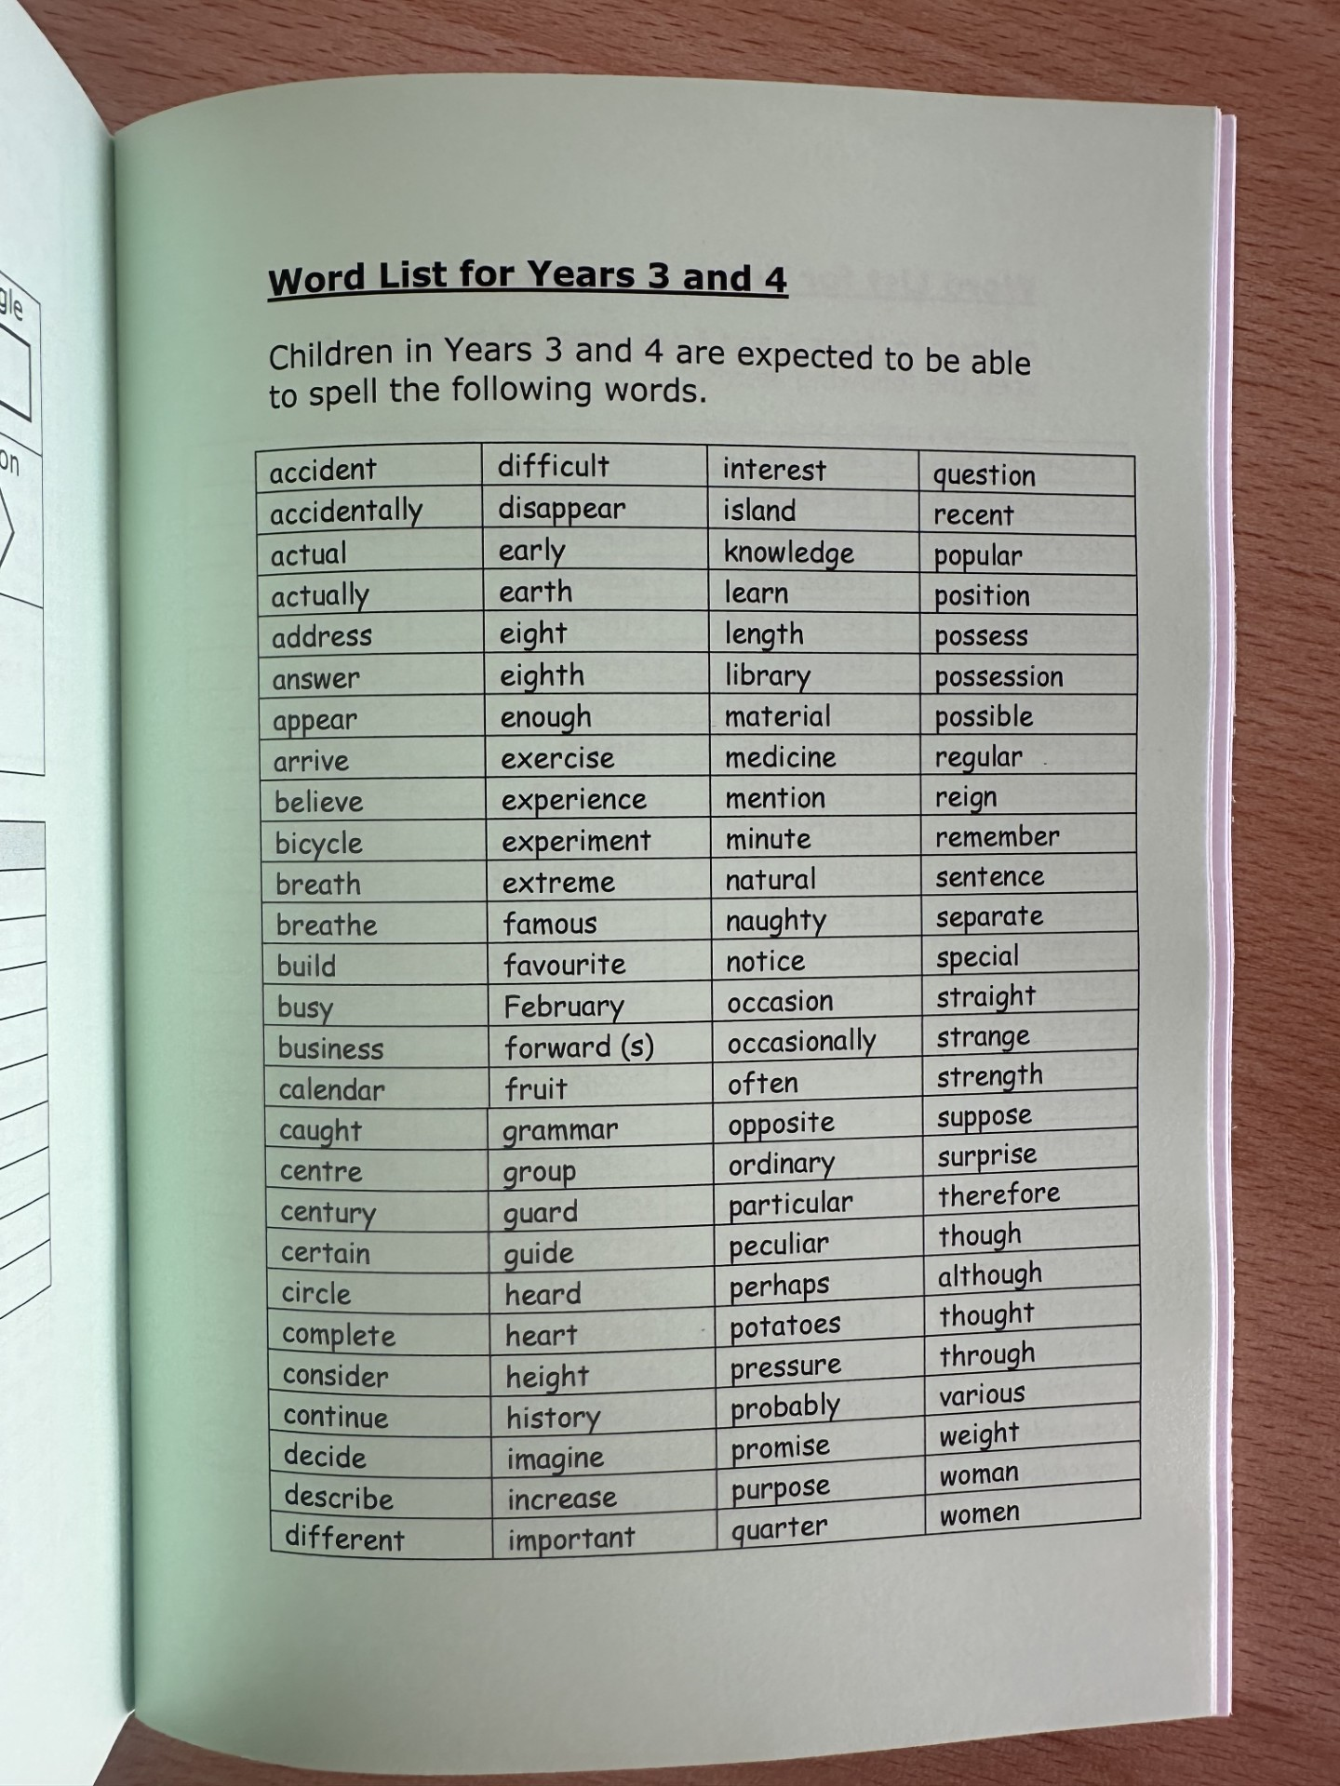
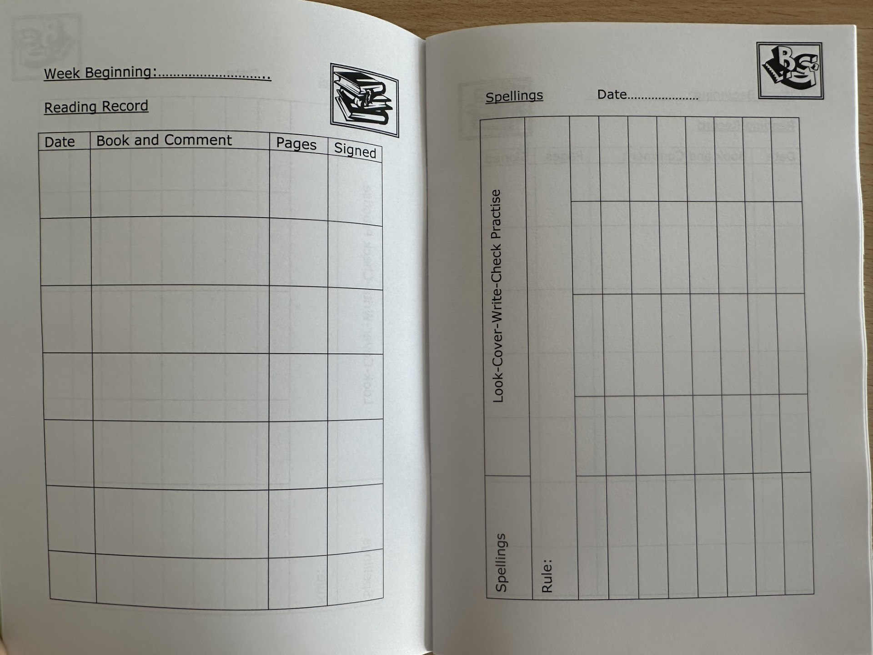
Spelling
Reading

Slide 12
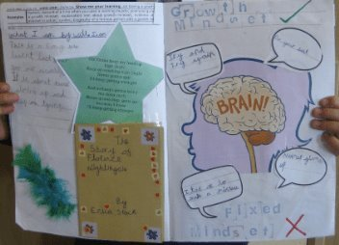
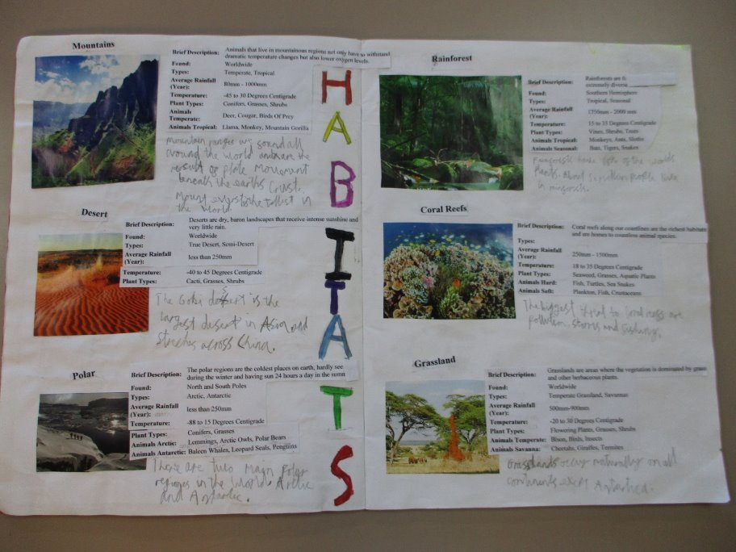
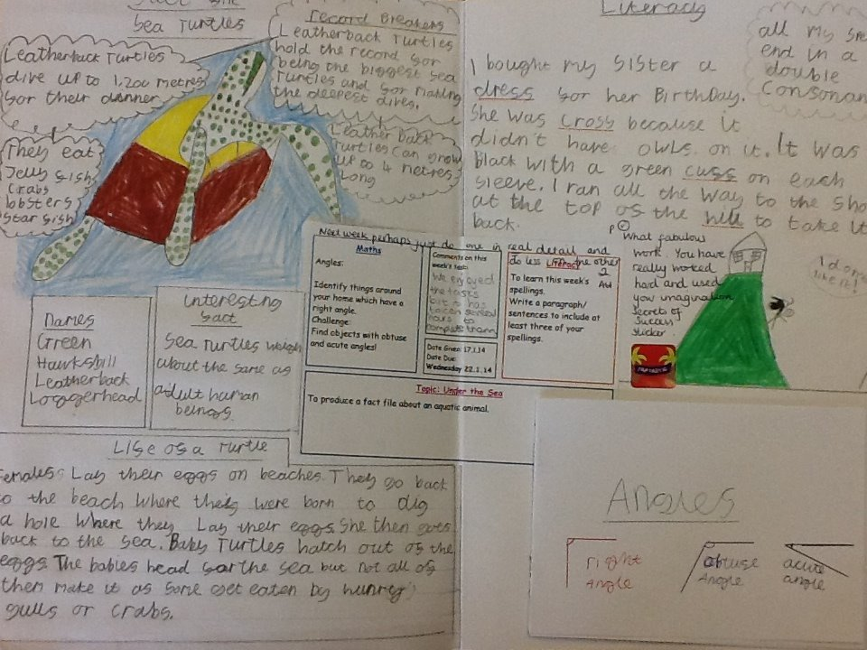
Homework

Slide 13
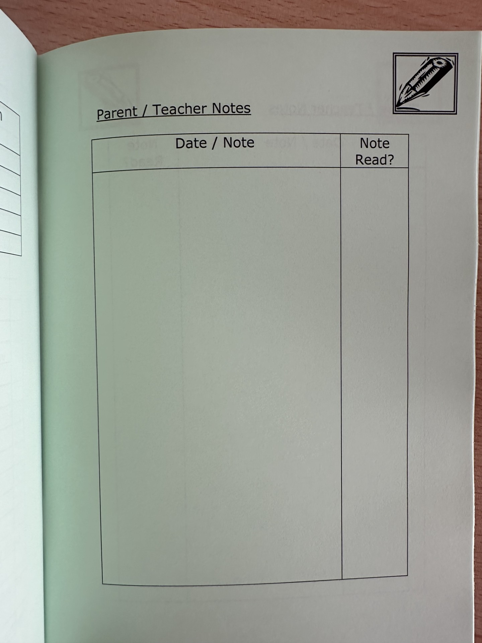
How do I get in contact?
A note to the teacher in your child’s home-school book.
An email to the teacher via the school office.
Catch-up on the
playground.

Slide 14
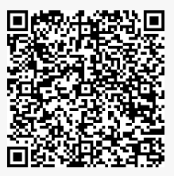
Trips and Upcoming Events
If you haven’t already, you need to give consent for your child to attend swimming lessons via coach. This needs to be completed by Monday 14th September.
Harvest Festival – Wednesday 7th October
AI5 Class Assembly – Thursday 19th November
EL5 Class Assembly – Thursday 10th December

Slide 15
Thank you!
Please take this chance to go and look around your child’s classroom and the teacher will be available to answer any questions you have!

