Slide 1
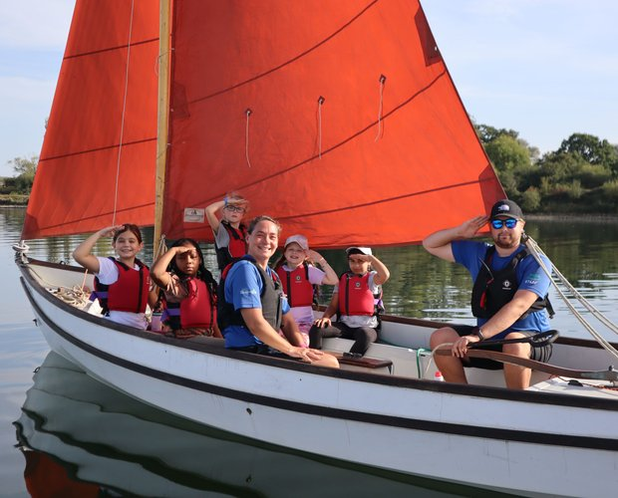
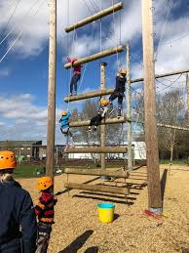
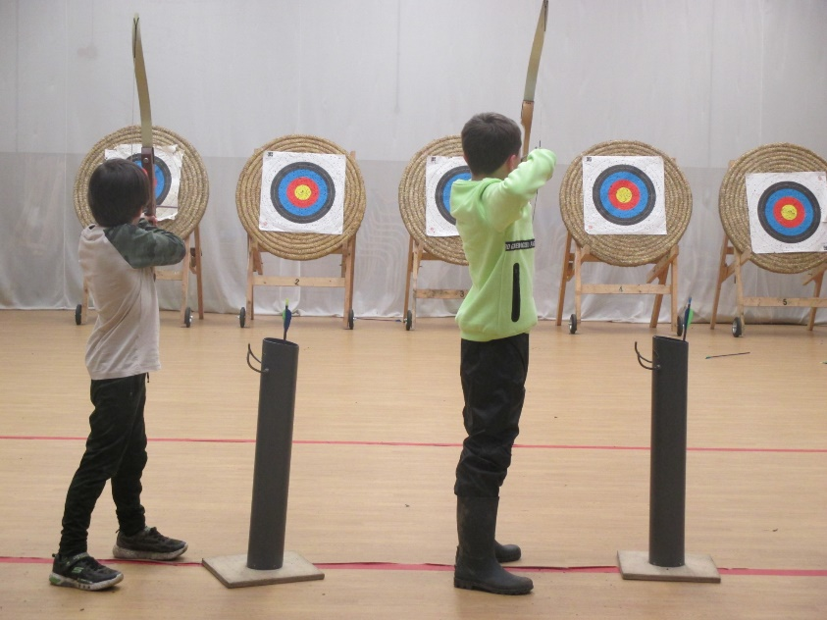
GRAFHAM WATER RESIDENTIAL TRIP
16th-18th March 2026

Slide 2
Aims of the trip
For children to take part in fun outdoor, adventurous activities, safely, guided by expert instructors as well as their teachers.
To experience staying over in a new place away from home.
Build new friendships.
To have new experiences and learn new skills.
To build trust and team work within the year group.
To develop resilience when faced with a challenge.

Slide 3
Grafham - Accommodation
Children will be placed in rooms of varying size – they have already given us the names of three friends that they would like to share with, and we will ensure they are with at least one of these people.
The children will find out which room they will be staying in when they arrive at Grafham.
Their rooms are different to the groups for the activities, but your child’s teacher will make sure your child is with people they are comfortable with.
‘Learning to make a bed, being responsible for their own belongings, sitting at a table and eating their dinner with their friends, learning to set a table for dinner, keeping their bedroom tidy, eating a healthy meal, going to sleep at a reasonable time so that they wake up the next morning ready to have a positive day taking part in adventurous activities……these are just some of the many benefits of a residential experience at GWC.’
– Grafham Water Centre Website (https://www.grafham-water-centre.co.uk/schools-colleges-and-youth-groups/residential-visits/)

Slide 4
Food
Dietary requirements have be sent to Grafham to ensure all children are catered for.
They will receive dinner on the Monday, three healthy meals on Tuesday, followed by breakfast and lunch on the Wednesday.
Lunch on Monday is not provided and children therefore need to bring a packed lunch (in disposable packaging).
We don’t currently have a menu from Grafham but to give you some idea, last years was…

Slide 5
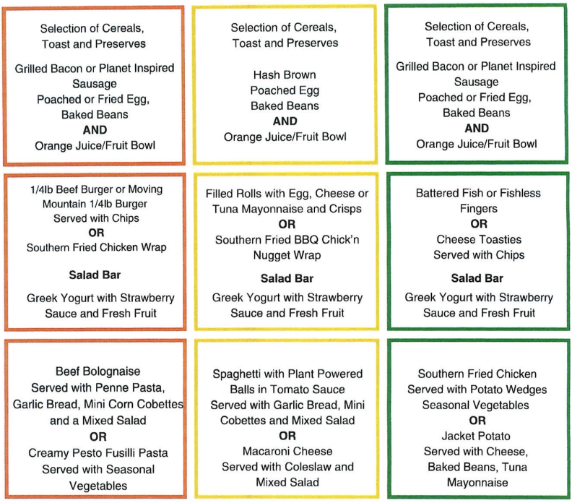
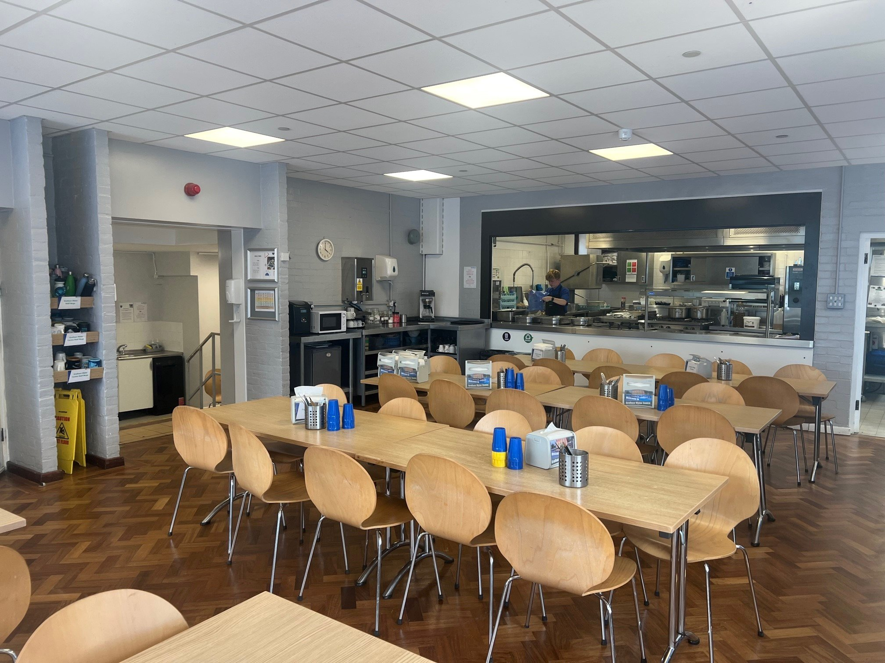

Slide 6
Staff Going
Miss Ingle
Mr Hodgkiss
Mrs Day
Miss Purser
Mrs Robertson
Mr Brolia
Mrs Miller
Miss Dean

Slide 7
Departure and Arrival
The children will need to arrive to school at normal time on Monday 16th March with their kit for the 3 days we will be away.
We aim to leave school at 10:00, if you fancied waving us off.
Children are required to bring a packed lunch for the first day (with a reusable water bottle)
We will return to school for collection slightly earlier than the usual time on Wednesday 18th March – You will receive a letter outlining how pick up will run (with regards to timings and suitcases etc.) and the children will need to be collected by an adult due to them being especially tired.

Slide 8
Grafham - Activities
This trip will be a great experience for all children. There are a wide range of activities planned throughout the day and the evening.
Just some of the activities the children will be taking part in are:
Archery
Canoeing
Crate stacking
Climbing (Indoors)
Powerboating
Grafham Water Centre require all children to wear/use the appropriate safety equipment (e.g. life jackets, helmets) which will be supplied for each child.

Slide 9
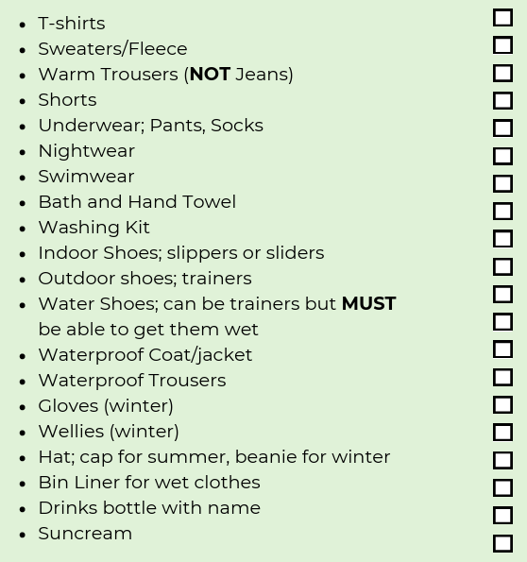
Kit List
We will give you a copy of the GWC kit list at the end!
During some of the activities your clothes may get wet and muddy, therefore you will need at least 1 full change of clothes per day.
It is better to have too much kit rather than not enough.
No electrical devices e.g. mobile phones, tablets – the Centre will not take any responsibility for these and under safeguarding regulations they must not be brought.
Please ensure all clothes are labelled with your child’s name.
No food is allowed in rooms so please do not pack any extra snacks.
Teddy’s/comfort blankets can be brought but children are responsible for own belongings so maybe avoid most prized possessions.
Lost property is held for TWO WEEKS at Grafham, before then being given to charity.
We recommend packing WITH the children, not FOR them – as this means they know where things are and what they have.

Slide 10

Mountain Warehouse
We are fortunate enough to have arranged a 20% off discount from Mountain Warehouse over the first weekend, and Monday, of half term (14th to 16th February).
All you have to do is go to the St Neots store and tell them you are from Priory Junior School.

Slide 11
Grafham - Medical
Thank you for returning your initial consent form for medication - If your child does require any medication throughout the trip this must be taken to the office for forms to be completed so that this can be administered appropriately during their stay. Please do this by Friday 13th March.
If anything has changed since you completed the form, or there are any dietary requirements/medical conditions that we are not aware of, please let Miss Ingle know this evening or email the school office.

Slide 12
Communication
A big purpose of a residential is to give the children a change to prove to themselves (any you) that they can look after themselves.
You will receive a daily text to update you on how we are getting on.
You can contact the office if there are any emergencies and they will contact us.
We will contact you if there is an emergency on our end (No Caller ID).

Slide 13
Questions
Does anybody have any questions?
Don’t forget to take a kit list! (we will also email this out to you tomorrow, alongside a letter summarising all the information that you have heard today)
There are still some outstanding payments so please make these to avoid the office chasing you!

