Slide 1
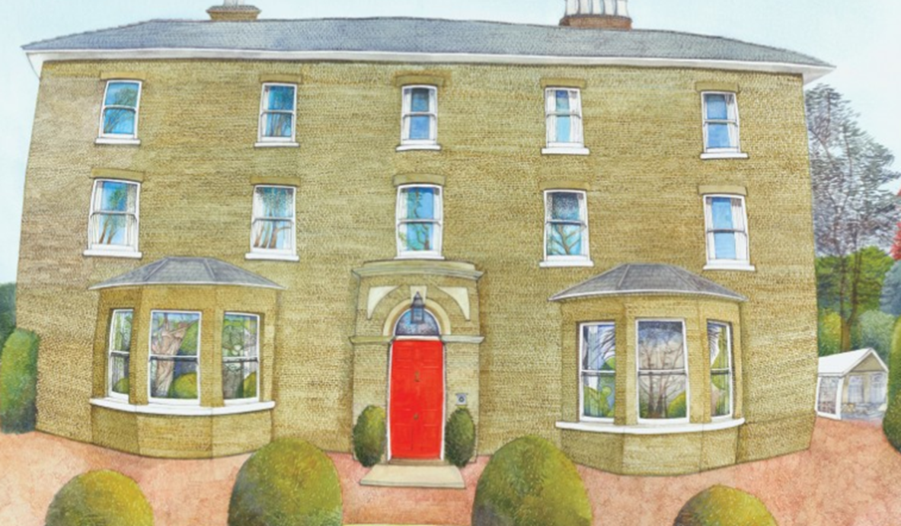
Year 4 Burwell House Residential
2026

Slide 2
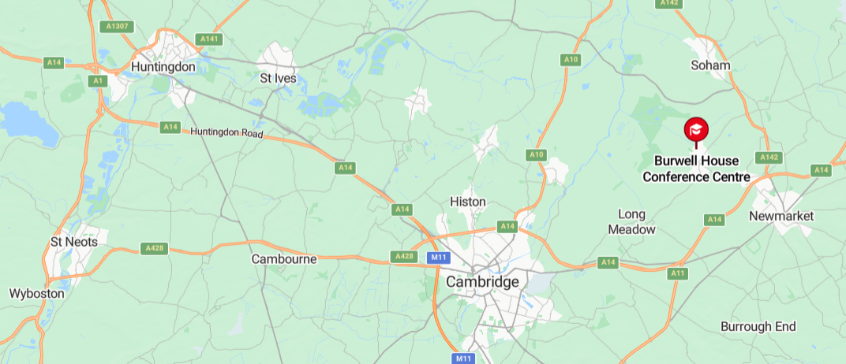
Where is Burwell?
Priory Junior School

Slide 3
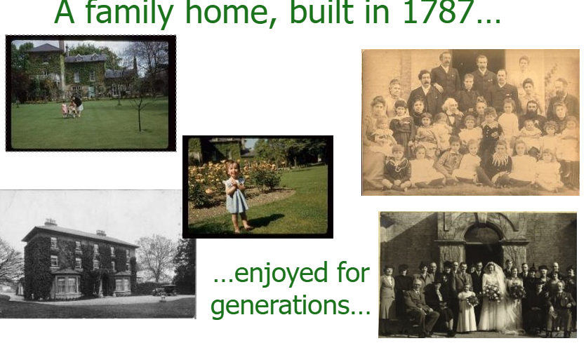

Slide 4


Slide 5
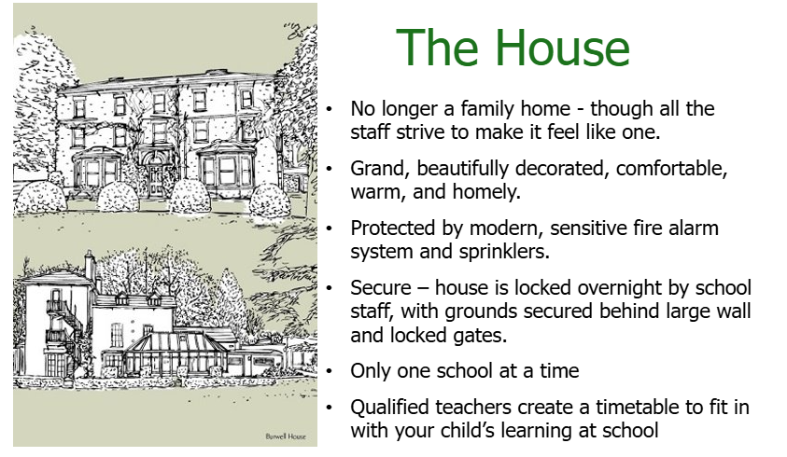

Slide 6
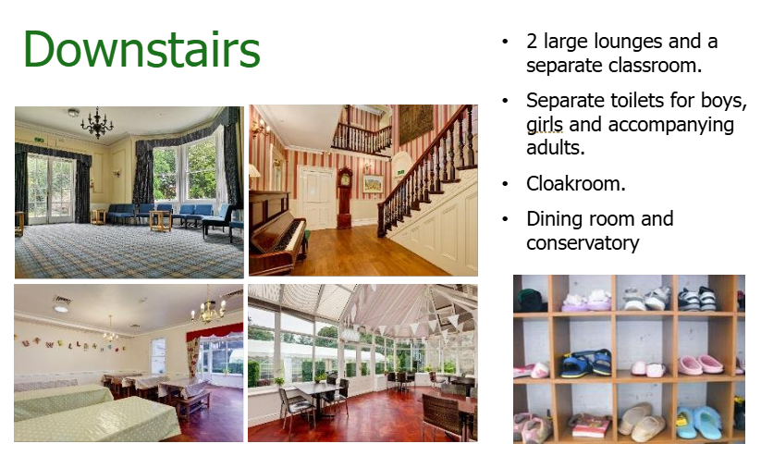

Slide 7
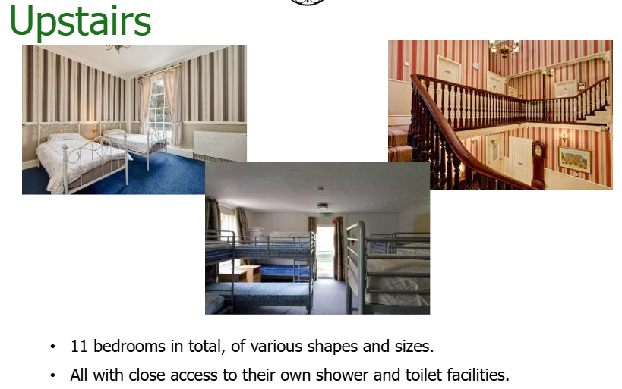

Slide 8
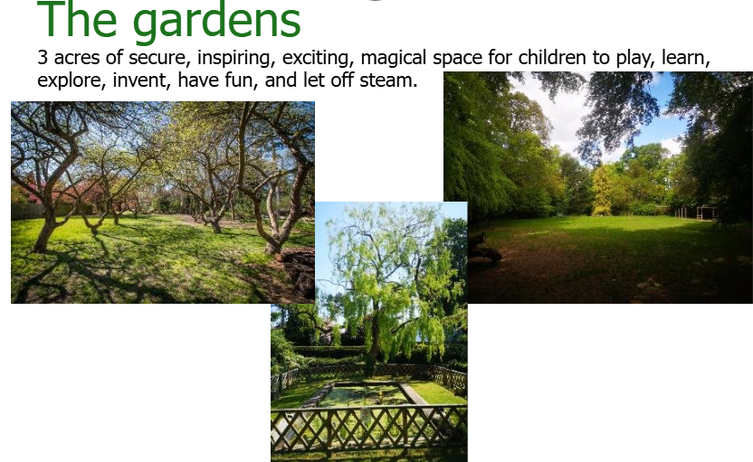

Slide 9
Aims of the trip
To experience spending a prolonged period of time in an outdoor environment.
Students will develop key skills such as creativity, resilience, confidence, problem‑solving, empathy, and effective communication.
To experience staying over in a new place from home.
To build trust and teamwork within the year group.

Slide 10
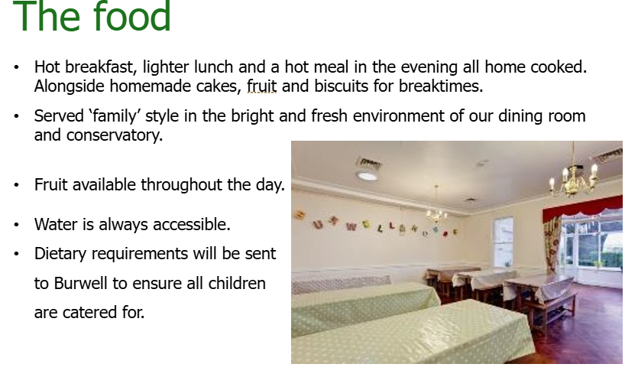

Slide 11
Example menu
Breakfast
A selection of cereals, yogurt, toast and fruit.
Lunch
Cheese and tomato pizza with salad (cherry tomatoes, cucumber and carrot sticks)
Jelly and ice cream
Dinner
Pasta with tomato sauce and garlic bread.
Apple crumble and cream
BBQ!

Slide 12
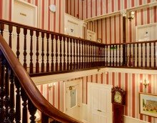
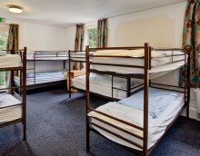
Bedrooms
Children will be placed in rooms of varying size.
They have already given us the names of three friends. We will ensure they will be with at least one of these people.
The children will be told their rooms when we arrive.

Slide 13
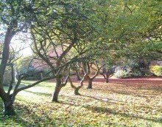
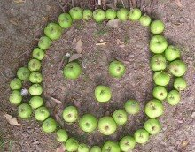
Activities
Snail Game
Natural Sculptures
Low Ropes
Firelighting / Shelter Building
Batik Bags
Burwell Fox
Burwell Orienteering Challenge
The Great Eggscape!

Slide 14
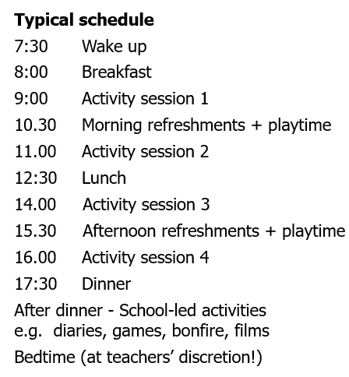
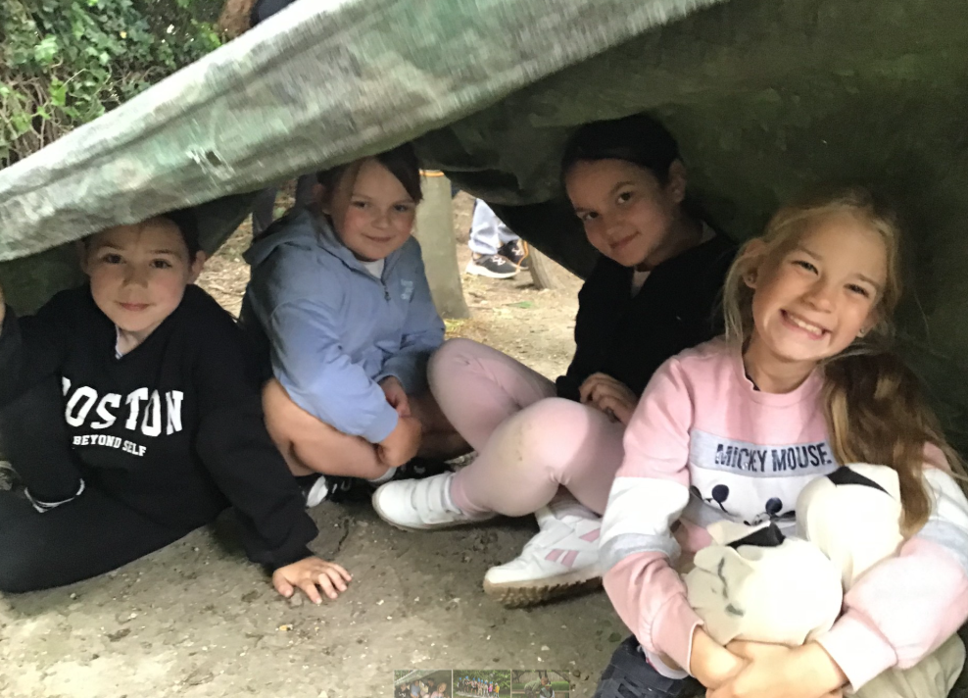
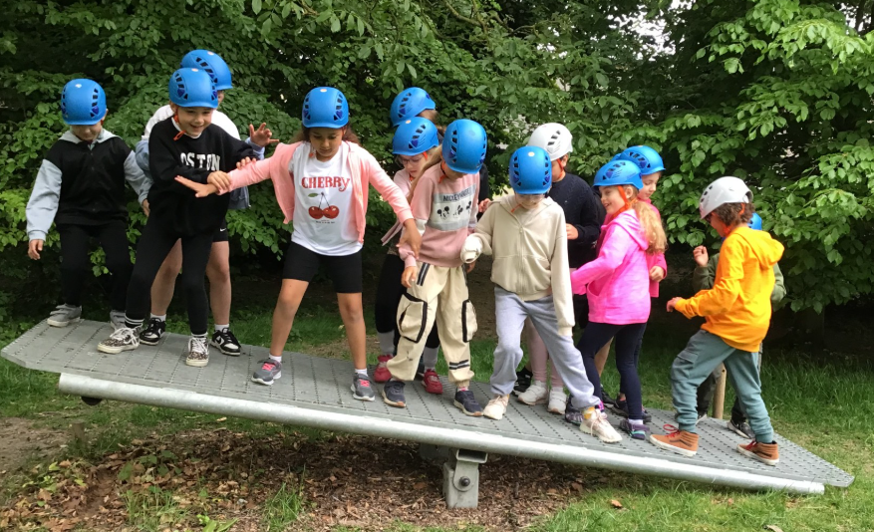
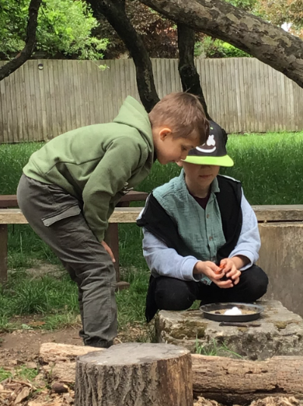
Activities

Slide 15
Staff
Group 1 ( LW4 and ½ EL4)
Miss Lygo
Mrs Wordley
Miss Dean
Mrs Queen
Group 2 ( TO4 and ½ EL4)
Miss Lygo
Miss Turner
Miss Dean

Slide 16
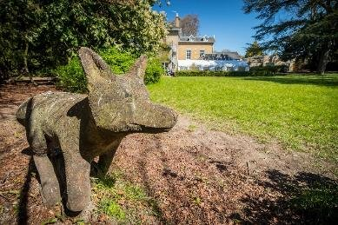
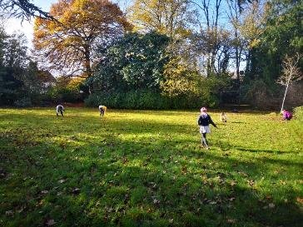
Departure and Arrival
The children will need to arrive to school at normal time.
We aim to leave school at 9:45, if you wanted to wave us off!
We will return to school for collection at the usual time.

Slide 17
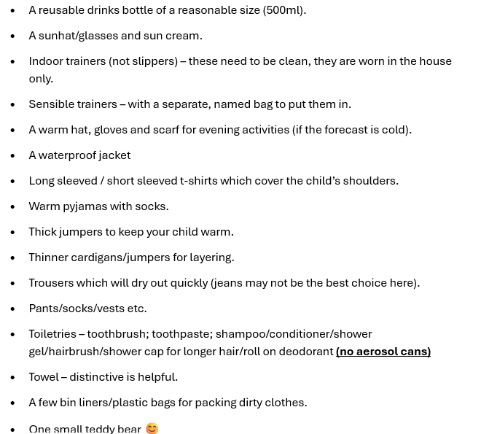
Kit List
It’s better to bring extra kit than not enough.
Pack spare clothes for muddy or wet activities.
No electrical devices (phones, tablets) — they are not allowed for safeguarding.
Label all clothing with your child’s name.
No food or snacks in rooms.
No medication in their bags.
No aerosols, as they can trigger fire alarms.

Slide 18

Mountain Warehouse
We are fortunate enough to have arranged a 20% off discount from Mountain Warehouse. This will take place Friday 3rd April – Monday 6th April (Easter Weekend).
All you have to do is go to the St Neots' store and tell them you are from Priory Junior School.

Slide 19
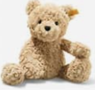
Some tips on how to support any worries!
Explore the Burwell House website together.
Involve your child in packing.
Go through these slides with them.
Choose one comforting item to take (e.g., teddy, book, colouring).
Remind them it’s an exciting first trip away for many children.
Let them know you’ll see them on the first and last day — it’s only one night away.
Pop a little note in their bag for them to find.

Slide 20
Communication
You will receive a daily text to update you on how we are getting on.
There will be updates on our school Facebook page.
You can contact the office if there are any emergencies and they will contact us.
We will contact you if there is an emergency or if we need to update you on anything at Burwell (No Caller ID).

Slide 21
Medical and Dietary Requirements
Please complete the forms document to inform us of any medical conditions or prescribed medication your child will need to take.
This form allows you to inform us of any allergies, intolerances or specific dietary requirements.
This form needs to be completed by Friday 27th March
If anything changes prior to the trip, please let the school office know.
We will send you a letter informing you of when to drop off your child's medication off at the school office after the Easter holidays.

Slide 22
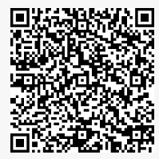
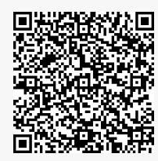
Questions?
There are print outs of the kit list at the front.
There are print outs of the letters asking you to complete your medical / dietary form. Here are the QR codes as well.
I will be in touch if you have requested a further chat via the form.
Group 1
Group 2

